Slide 1
Comments on Rethinking the Effect of informality on Inclusive Growth: Lessons from Colombia and South Africa
Angel Melguizo
ELLA Summit on Informality and Inclusive Growth
Johannesburg, October 4-5 2016

Slide 2
Comments on Rethinking the Effect of informality on Inclusive Growth: Colombia and South Africa
Analyses the impact of informality on inclusive growth, applied empirically to Colombia and South Africa
Analysis of inclusive growth is very timely: low-growth trap and increasing inequalities
Informal is normal (in most emerging economies)
Informalities mean different policy recommendations

Slide 3
Comments on Rethinking the Effect of informality on Inclusive Growth: Colombia and South Africa
Colombia vs South Africa
Many socio-economic similarities (and some diff.)

Slide 4
Comments on Rethinking the Effect of informality on Inclusive Growth: Colombia and South Africa
Methodology
Results
Comments

Slide 5
Comments on Rethinking the Effect of informality on Inclusive Growth: Colombia and South Africa
Methodology
Results
Comments

Slide 6
Methodology (I)
Original conceptual framework

Slide 7
Methodology (and II)
Assumptions on types of informality and their impact inclusive growth
Voluntary + micro - macro
Subsistence + micro + macro (short-run)
Induced - micro - macro
Empirical analysis for Colombia and South Africa (plus Sub-Saharan Africa and Latin America)
Survey data (household surveys)

Slide 8
Comments on Rethinking the Effect of informality on Inclusive Growth: Colombia and South Africa
Methodology
Results
Comments

Slide 9
Results
Informality is higher in Colombia than in South Africa
55% (40-65) vs 30% (20-70)
Heterogeneity among informal workers
Voluntary/Subsistence/Induced (1/3) in Colombia
Mostly Subsistence in South Africa
Policy recommendations to foster inclusive growth
→ Policy pack (implicit + explicit barriers)

Slide 10
Comments on Rethinking the Effect of informality on Inclusive Growth: Colombia and South Africa
Methodology
Results
Comments

Slide 11
Comments (Ia)
Nice conceptual framework: informalities
Source: Bosch, M., C. Pages and A. Melguizo (2013), Better Pensions, Better Jobs. IDB

Slide 12
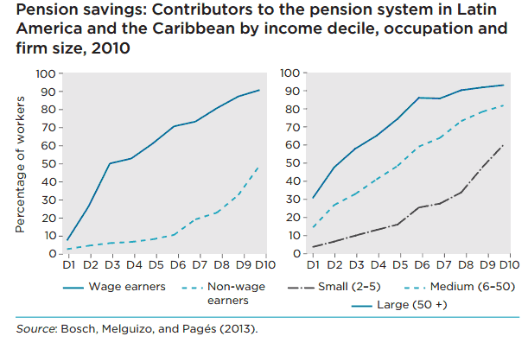
Comments (Ib)
Nice conceptual framework: informalities
Source: Bosch, M., C. Pages and A. Melguizo (2013), Better Pensions, Better Jobs. IDB

Slide 13
Comments (II)
Convincing empirical analysis (methodology & sources), especially preference/prevented
Dimension | Indicator | South Africa | Colombia Total | Colombia 13-areas
Choice | Transition between informality and formality | Medium (26%) |  | Low (14%)
 | Preferences for informality- surveys | Very low (22%) | Low (35.9%) | Low (41.5%)
 | Cyclicality: coefficient of correlation | Pro-cyclical -0.38 using lagged GDP, 0.63 using GDP |  | Counter-cyclical -0.42%**, using output gap
Barriers to Formality | Indicators of segregation. Relative probability of being informal | High Women (1.1***) Ethnic differences: (0.49***, White 0.3*** and Asian 0.5***, relative to Africans) | Medium Women (1.5***) Ethnic minorities: probability of informality is 5.4 p.p higher for indigenous people and 2.2 p.p higher for afro-Colombians | Medium Women (1.5***)
 | Minimum wage / average wage | Low (17%) (wholesale and retail sector) | High (66%) | High (55%)
 | Labour tax / commercial profits | Low (4%) | Medium high (18.6%)

Slide 14
Comments (III)
Distinction subsistence vs induced might be not so clear (e.g. minimum wage * labor taxes)
Informality and theoretical formalisation costs
Source: OECD/CIAT/IDB (2016), Taxing Wages in Latin America and the Caribbean.

Slide 15
Comments (IV)
Any chance to analysis flows among types of informals? Is subsistence informality a trap?
Informality vs Subsistence entrepreneurs
Source: OECD/ECLAC/CAF (2016), Latin American Economic Outlook 2017. Forthcoming

Slide 16
Comments (V)
Analysis by socio-economic groups – Informality among the vulnerable middle-class
Source: Melguizo, A. (2015), Pensions, Informality and the Emerging Middle Class. IZA World of Labor.

Slide 17
Comments (and VI)
Elasticities: informality(ies) vs implicit and explicit barriers
Source: Gonzalez-Paramo, J.M. and A. Melguizo. (2013), Who pays labour taxes and social contributions? A meta-analysis approach. SERIES, 4, 247-71

Slide 18
Thanks!
Angel Melguizo
ELLA Summit on Informality and Inclusive Growth
Johannesburg, October 4-5 2016

