Slide 1
The economics of the Arab Spring and its aftermath
Shanta Devarajan
World Bank
www.brookings.edu/futuredevelopment

Slide 2
Before 2011, poverty rates in MENA were low
Source: PovcalNet, World Bank.

Slide 3
and declining
Poverty rates in MENA (% of population)
Source: PovcalNet, World Bank.

Slide 4
Income of the bottom 40 percent grew faster than average
Source: World Development Indicators, World Bank.

Slide 5
Child mortality fell rapidly
Source: Iqbal and Kiendrebeogo (2014). “The reduction of child mortality in MENA: A success story”.

Slide 6
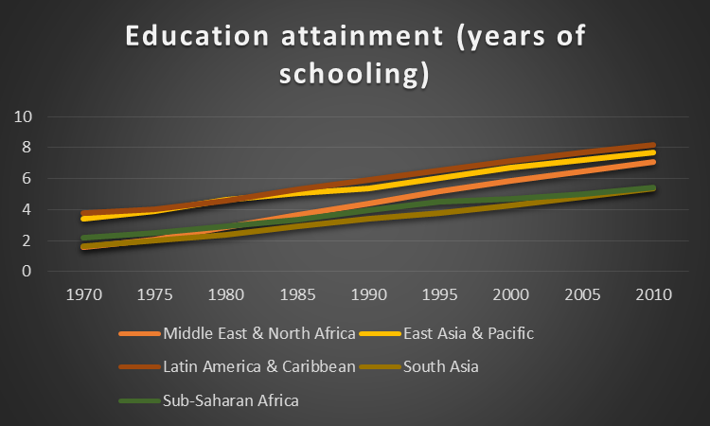
Progress in education attainment

Slide 7
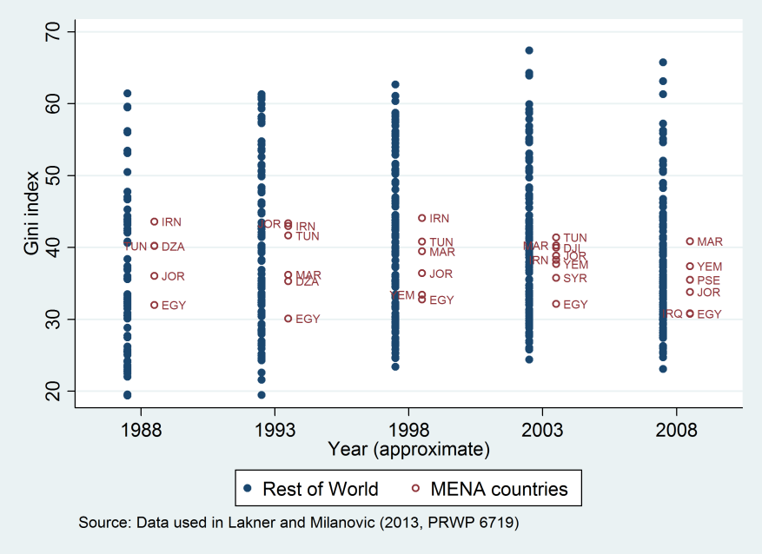
Inequality was low and declining

Slide 8
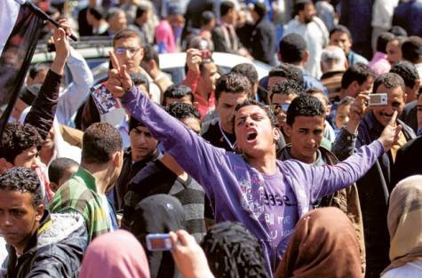
Yet, there were revolutions in 4 countries and
protests in several others

Slide 9
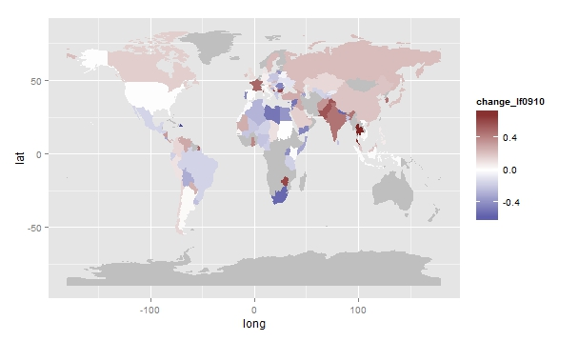
Perceptions of wellbeing were plummeting
Change in average life satisfaction levels, 2009-10
Source: Ianchovichina et al. (2015) based on Gallup World Poll data.

Slide 10
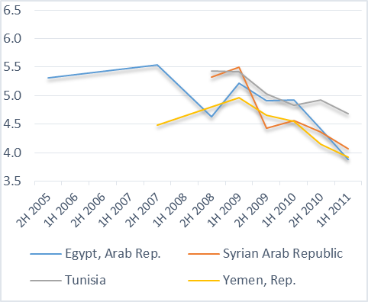
especially in the Arab Spring countries
Evolution of life satisfaction during the second half of the 2000s

Slide 11
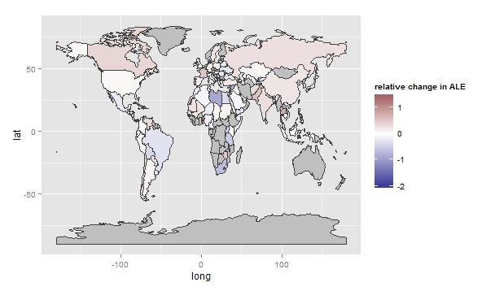
Declines were larger for the middle class than the poor
Change in average life satisfaction levels of the top 60 percent
relative to the bottom 40 percent, 2009-10
Source: Ianchovichina et al. (2015) based on Gallup World Poll data.

Slide 12
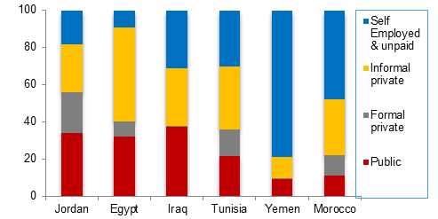
The old social contract: (1) Jobs in the public sector

Slide 13
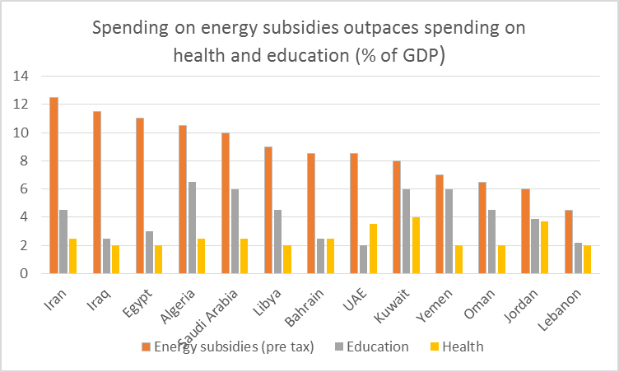
The old social contract: (2) Subsidized energy, free education and health

Slide 14
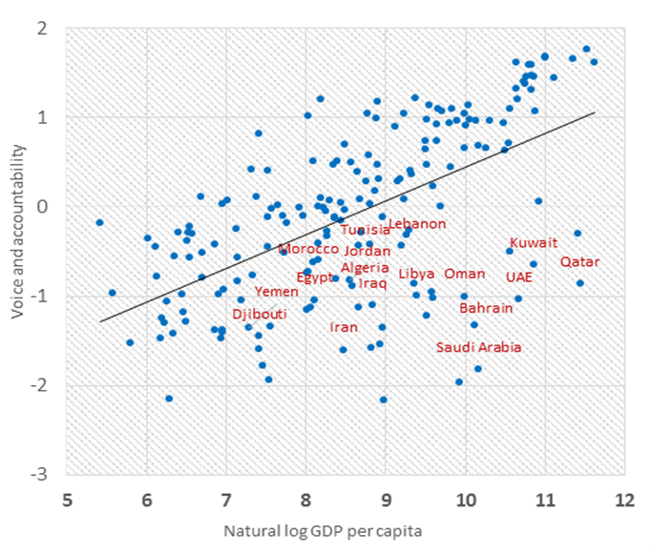

The old social contract: (3) Limited voice and accountability

Slide 15
Broken social contract: (1) Unemployment
Source: World Development Indicators, World Bank.

Slide 16
especially among highly educated people
Unemployed with tertiary education (% of total unemployment)
Unemployment rates (2009, % )
Egypt
Jordan
Tunisia
Iran
Percent
Source: World Bank, latest available year.
Notes:
The labor force was growing at a rapid rate (fastest in the world)
And unemployment was also highest in the world
Especially high for young people and women

Slide 17
Most of the male labor force
is engaged in the informal sector
Egypt: job status by region, male labor force participation aged 15-24, %
Source: World Bank.

Slide 18
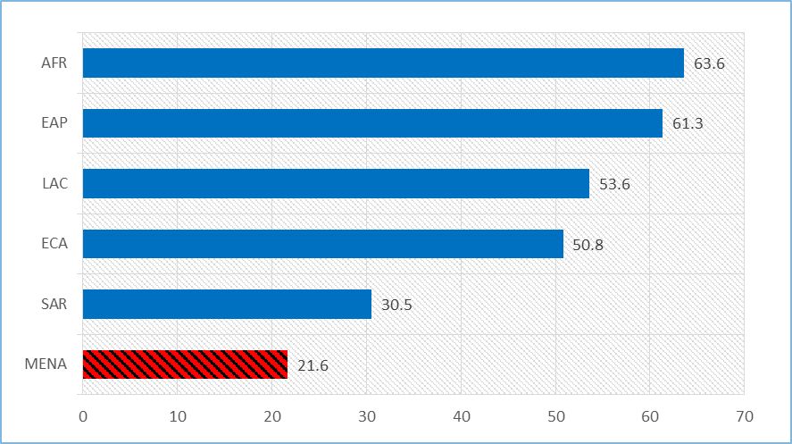
Lowest female labor force participation rate in the world

Slide 19
Net job creation by firm size and age Green=Growth, Red=Reduction
Notes:
Ou sont les postes crées? C’est exclusivement dans les entreprises jeunes, et surtout dans les entreprises très petites (1 a 3 travailleurs).

Slide 20
Stunted growth
Short-term transaction matrix Annual Transitions
Tunisia – All Firms Status in year t+1 |  |  |  |  |  | Morocco – Manufacturing only Status in year t+1
Status in year t | Exited | 1-person | Micro | Small | Large | Status in year t | Exited | Micro | Small | Large
1-person | 5,3% | 90,6% | 3,8% | 0,2% | 0,0%
Micro | 3,3% | 10,6% | 83,9% | 2,1% | 0,0% | Micro | 11.1% | 81.0% | 7.9% | 0.0%
Small | 1,8% | 7,1% | 10,1% | 78,4% | 2,6% | Small | 6.9% | 6.8% | 83.6% | 2.7%
Large | 1,1% | 3,1% | 1,5% | 10,3% | 84,0% | Large | 5.1% | 0.1% | 7.6% | 87.1%
Long-term transaction matrix Decadal Transitions
Tunisia – All Firms Status in year t+10 |  |  |  |  |  | Morocco – Manufacturing only Status in year t+10
Status in year t | Exited | 1-person | Micro | Small | Large | Status in year t | Exited | Micro | Small | Large
1-person | 30,8% | 65,5% | 3,4% | 0,3% | 0,0%
Micro | 19,0% | 41,2% | 37,0% | 2,8% | 0,1% | Micro | 52.1% | 36.5% | 11.3% | 0.1%
Small | 14,8% | 28,4% | 14,0% | 39,5% | 3,3% | Small | 44.6% | 9.5% | 41.2% | 4.8%
Large | 15,8% | 23,3% | 2,9% | 15,2% | 42,7% | Large | 40.7% | 0.6% | 12.9% | 45.9%
Most small firms remain small ----- even in the long run
Notes:
Le plupart des entreprises restent dans leur proper segment—10 ans apres.

Slide 21
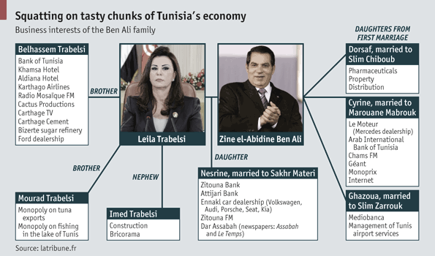
Sluggish private sector connected to privilege
Source: The Economist.

Slide 22
Regulations favored connected firms in Tunisia
 | Ben Ali firms |  |  | Other firms
 | N | Mean | Sum (USD) | N | Mean | Sum (USD) | Ben Ali Share of Total
L | 127 | 66 | 8,392 | 112309 | 9 | 1,036,610 | 0.80%
Y | 122 | 16,980,822 | 2,071,660,240 | 307430 | 225,300 | 62,512,270,119 | 3.20%
Net Profits | 122 | 1,908,925 | 232,888,796 | 96859 | 11,090 | 1,074,153,638 | 21.30%
Gross Profits | 122 | 2,811,035 | 342,946,258 | 96859 | 54,320 | 5,261,372,574 | 6.80%
Gross Losses | 122 | -902,110 | -110,057,441 | 96859 | -43,230 | -4,187,219,068 | 2.70%
Note: USD:TND exchange rate1:1.5146, data for 2010, L=wage workers, Y=output, Net profits=pre-tax profits declared to the tax authorities (all firms), gross profits=pre-tax profits declared to the tax-authorities only for firms for whom this is positive. Gross losses=tax profits declared to the tax authorities only for firms for whom this is negative.
Source: Rijkers, Freund and Nucifora, “All in the family: State capture in Tunisia,” 2014.
Notes:
More fundamentally, growth has been slow

Slide 23
Regulations favored connected firms in Egypt
Net profits of PC firms relative to other (Orbis) firms
Source: Diwan, Keefer and Schiffbauer, “Private Sector Growth and Crony Capitalism in Egypt,” 2013.
Notes:
More fundamentally, growth has been slow

Slide 24
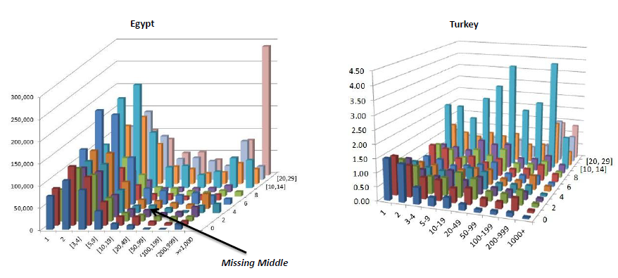
Private sector lacks dynamism
Distribution of employment by firm size and age
age
size
Source: Marc Schiffbauer et al., 2015, Jobs or Privileges. World Bank.
Notes:
Small firms never grow
Need middle sized firms to grow and create jobs

Slide 25
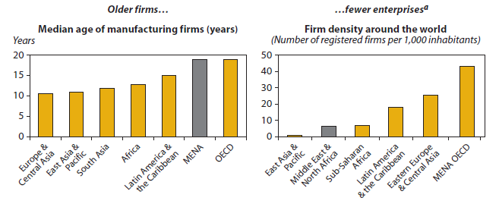
Not enough startups?

Slide 26
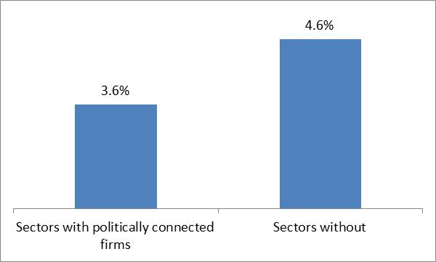
Privileges suppress the firm dynamics associated with job creation
In Egypt, job growth declines by about 1.4%-points annually when connected firms enter new, previously unconnected sectors.
Firm startup is lower in sectors dominated by politically connected firms
Notes:
La faite est les entreprises dynamiques n’entrent pas dans les secteurs avec les entprises connectees.
Perte de l’employ: 1.4 pourcent quand une entreprise connectee entrent dans un secteur non-connecte.

Slide 27
Broken social contract:
(2) Poor quality public services
Source: PISA Math 2012.

Slide 28
Why are learning outcomes poor?
Source: TIMSS 2011.

Slide 29
“Connections are critical to getting a job (wasta)”

Slide 30
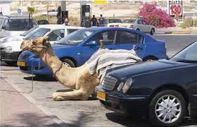
Broken social contract:
(3) Energy and water subsidies backfired
Allocated mostly to the rich

Slide 31
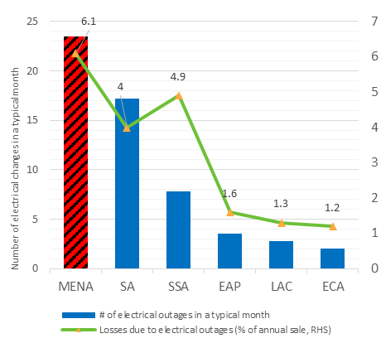
Poor service quality

Slide 32
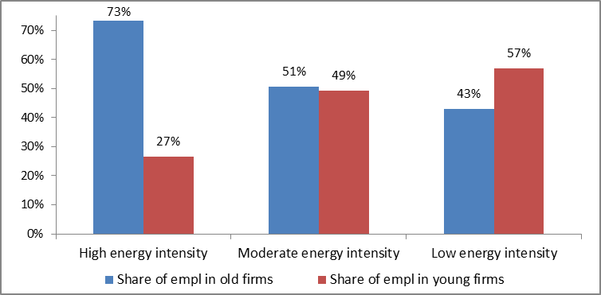
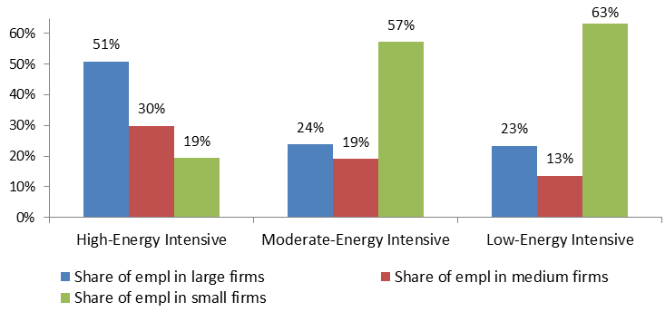
Contributed to unemployment: bias against small, young (job creating) firms
Source: Schiffbauer, M. and others, Jobs or Privileges, World Bank 2014.

Slide 33
Elements of a new social contract
State provides
Level playing field for business
Accountability in service delivery
Cash transfers
Citizens
Pay market prices for private goods
Active participants in economy and service delivery

Slide 34
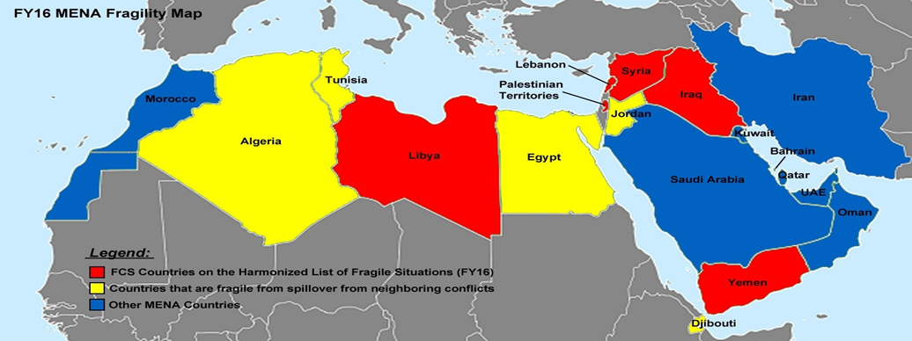
Today, the MENA region is in turmoil

Slide 35
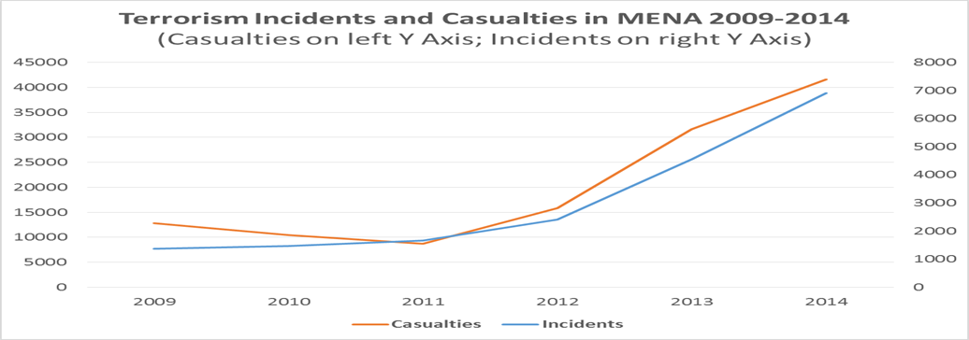
Terrorism is on the rise

Slide 36
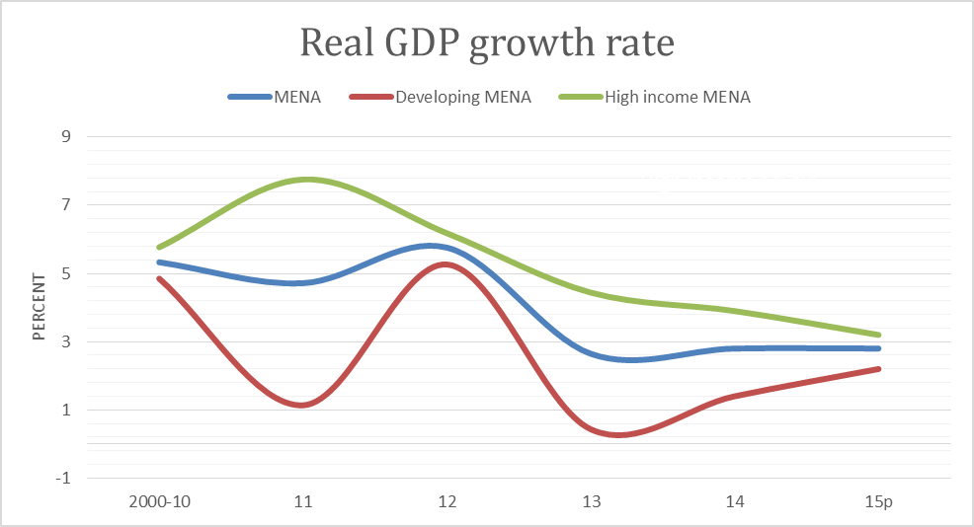
Growth has collapsed

Slide 37
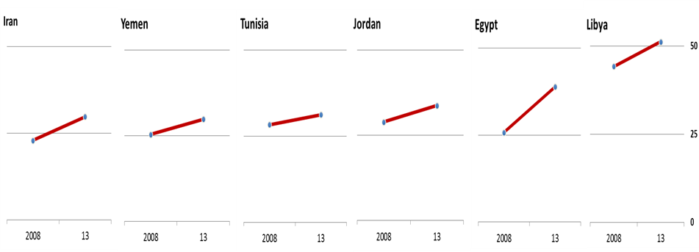
Unemployment on the rise
Youth unemployment (% of total labor force ages 15-24)

Slide 38
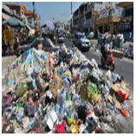
How to get there?
Use diagnosis to identify tradeoffs between
Employment and cronyism
Service quality and subsidies
Water availability and fuel and water subsidies
Poor learning outcomes and accountability in service delivery

Slide 39
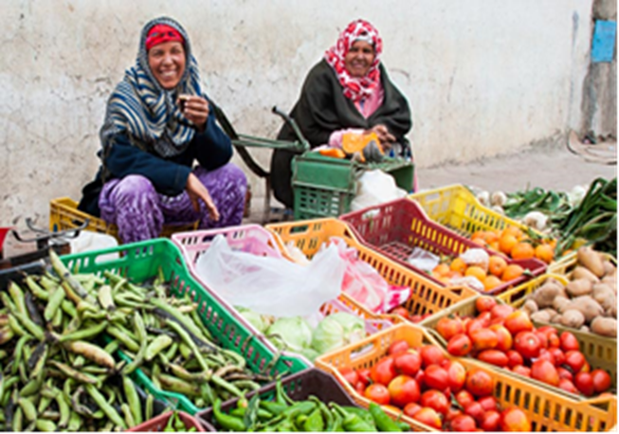
How to get there?
Build on local successes that reflect the new social contract
Kufor Quod Girls’ Secondary School in the West Bank
Zeid Ben Haritha Secondary School in Jordan
Morocco’s “Concours Qualité” program in health
Community-driven agriculture in Yemen and Tunisia

Slide 40

How to get there?
Differentiated by country types
Transition countries (Egypt, Tunisia, Morocco, Jordan, Lebanon)
Dialogue on new social contract now
Important for managing refugees
Contributes to social stability
Civil war countries (Syria, Iraq, Yemen, Libya)
Stabilize conflict first
New social contract essential to post-conflict reconstruction
Others (Algeria, Iran, GCC)
Start introducing new social contract to address unemployment, service delivery problems
May avoid disruptive conflict

