Slide 1
Measuring Tobacco Tax Avoidance and Evasion
Hana Ross, PhD
School of Economics
University of Cape Town

Slide 2
11 Methods to Estimate the Scope of Tax Avoidance/Evasion
  Surveys of tobacco users (WB)
  Examination of cigarette packs obtained from smokers (WB)
  Examination of discarded cigarette packs
  Examination of cigarette packs obtained from retail
  Comparison of sales with consumption (Gap Analysis) (WB)
  Econometric modeling (WB)
  Comparison of tax paid sales with estimated consumption
  Comparison of actual and projected tobacco tax revenue
  Key informant interviews (WB)
  Monitoring tobacco trade (WB)
  Analyzing seizures of illegally transported tobacco

Slide 3
Examination of Cigarette Packs (3 Methods)
  When to use:
  Pack’s features allow determination whether taxes were paid
  Budget considerations: costs depend on the sources of packs and the representativeness of the sample
  Estimates are not needed quickly

Slide 4

Diamond Tax Stamp in SA

Slide 5

Tax Stamp Mongolia
Authenticity can
be verified by a
smart phone app

Slide 6
Examination of Cigarette Packs (continued)
  Observational study: classifying packs as low-tax or full-tax products
  Source of packs:
    tobacco users;
    retail outlets;
    collected on the street and in trash
  Costs can be reduced if data collection added to an existing survey; packs from streets are cheaper compared to packs from users, but representativeness of the sample limited.

Slide 7
Examination of Cigarette Packs (continued)
  Features to examine:
  the absence of the correct tax stamp,
  an incorrect health warning,
  markings of a duty-free store,
  missing price information (if required by the law),
  low price,
  other features of a pack required by the law.

Slide 8
Examination of Cigarette Packs (continued)
  Steps:
  develop a sampling frame (aiming for a representative sample);
  train pack collectors;
  collect data (possession of unopened packs preferred due to the tax stamp possible damage; ask for all open packs);
  inspect packs and record data (standard questionnaire, double recording).

Slide 9
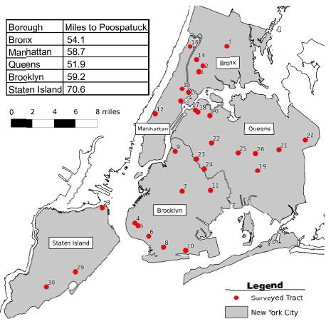
Maps of NYC Census Tracts

Slide 10
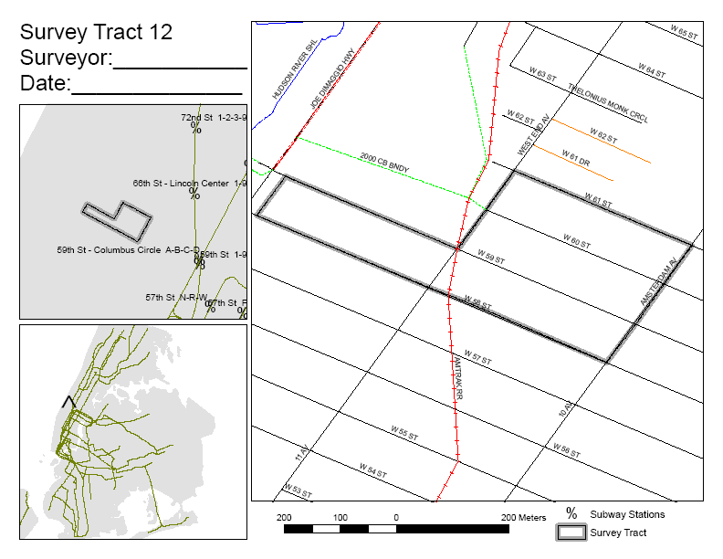
Typical Tract Map

Slide 11
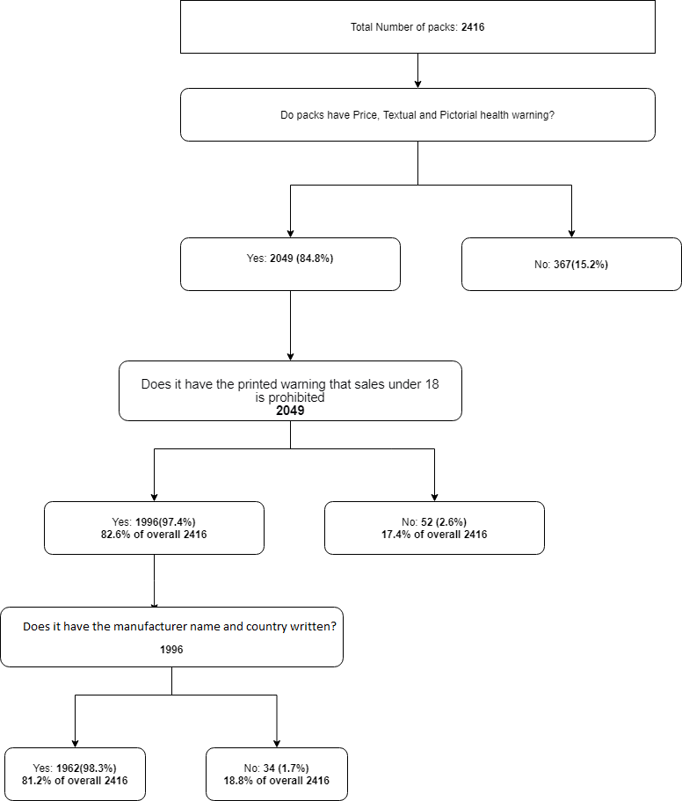

Slide 12
Examination of Cigarette Packs (continued)
  Advantages:
  Eliminates the validity problems associated with self-reported data
  Disadvantages:
  Difficulty to separate tax evasion from tax avoidance without info from users, a lab, assumptions about tourists/commuters (with the exception of retail surveys)
  The generalization of the results can be limited for packs from streets, trash bins, retail stores

Slide 13
Surveys of Tobacco Users
    Smokers can tell us what they smoke, where they bought it, how much it cost.
  When to use:
  When the users’ purchasing behaviour and/or the self-reported features of a cigarette pack allow one to determine whether taxes were paid
  Budget considerations: generating a representative sample can be costly
  Estimates are not needed quickly

Slide 14
Surveys of Tobacco Users
(continued)
  Steps:
  Decide the survey mode – face-to-face, telephone, mailing in a questionnaire, via Internet (impact on the accuracy, representativeness, the costs)
  Develop a sampling frame and sample size (aiming for a representative sample of smokers)
  Decide the unit of observation (e.g. household, tobacco user – selecting only those who consume low-tax products will generate biased results)

Slide 15
Surveys of Tobacco Users
(continued)
  Steps:
  Develop questionnaire – Objective questions preferable (e.g. quantity and the frequency of low-tax purchases; socio-econ characteristics); can also obtain subjective opinion on whether the full-tax has been collected
  Collect data in relatively short period of time
  Analyze the data (% of smokers who possessed low-tax cigarettes; % of low-tax cigarettes consumed by those who possessed them; account for smoking intensity among those consuming low-tax products; % of low-tax cigarettes among those surveyed, and among the entire population after applying the appropriate weights)

Slide 16
Examination of Cigarette Packs (continued)
  Advantages:
  Can distinguish between tax avoidance and tax evasion.
  One of the most direct methods of obtaining estimates of the scope of tobacco tax avoidance and of availability of low-tax products via various supply channels
  Disadvantages:
  Tent to understate tax evasion: Do users know if they are smoking illicit product?; Voluntary participation – may under-report using illicit products; It is recommended to combine it with an independent examination of cigarette packs.
  Relatively expensive

Slide 17
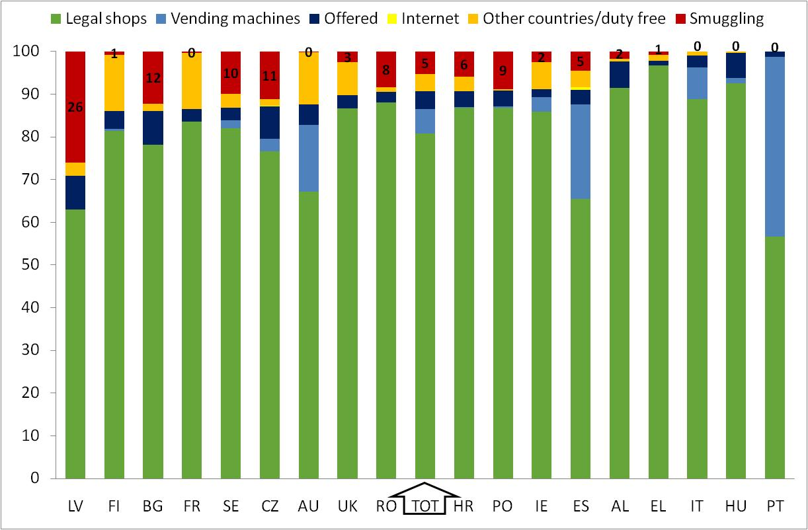
Separating Tax Avoidance and Evasion in the EU
Source: PPACTE Survey 2010
Notes:
Current smokers showed their latest purchased pack.
A pack was illicit if it had at least one of the following tax evasion indicators: (1) it was bought from illicit sources, as reported by smokers, (2) it had an inappropriate tax
stamp, (3) it had an inappropriate health warning or (4) its price was substantially below the known price in their market.
Source “offered” was deemed illicit.

Slide 18


Combining 2 Methods
  Collection of data in Warsaw from:
  Packs discarded on streets in Warsaw in September 2008 (N=761) and September 2011 (N=754)
  Packs in smokers’ personal possession in Warsaw in September 2011 (N=400)
Notes:
What the tobacco industry keeps secret, though, is that the smuggling estimates used in their lobbying efforts are directly commissioned by the industry itself
Unlike academic research studies, these studies provide only limited information about their methodology and data collection, thus are not replicable
As data on cigarette smuggling has become ever more crucial to the shaping of public health policy, we decided to take a closer look at the industry’s studies. In 2008 and 2011, we conducted surveys using transparent and rigorous academic methods to estimate the scale of cigarette smuggling in Warsaw, Poland.

Slide 19
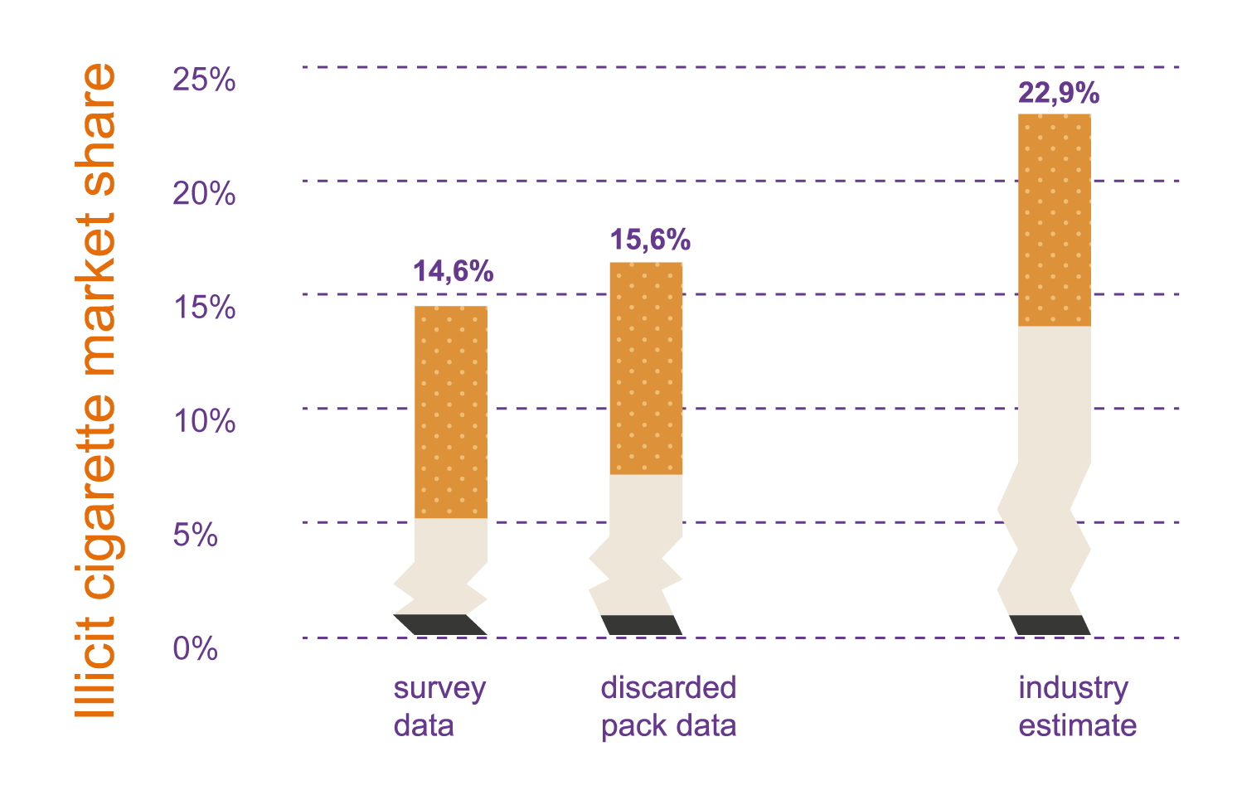
Academic and Tobacco Industry Estimates, Warsaw, Poland (2011)
Notes:
What the tobacco industry keeps secret, though, is that the smuggling estimates used in their lobbying efforts are directly commissioned by the industry itself
As data on cigarette smuggling has become ever more crucial to the shaping of public health policy, two economists from the ACS Intramural Research department, Michal Stoklosa and Hana Ross, decided to take a closer look at the industry’s studies. In 2011, Society researchers conducted two surveys using transparent and rigorous academic methods to estimate the scale of cigarette smuggling in Warsaw, Poland. The surveys were conducted at the same time as a study commissioned by the four largest tobacco companies in Europe. The Society surveys used two methods: collecting littered cigarette packs, a technique similar to the one used by the tobacco industry, as well as face-to-face interviews that asked smokers to show the researchers their cigarette packs.
The Society study’s results were definitive. While both academic methods produced identical estimates of the scale cigarette smuggling, the tobacco industry commissioned estimate was higher by nearly half compared to what the Society researchers found (15% v. 23% of all cigarettes were smuggled). The reason for this difference is unknowable because the tobacco industry refuses to disclose the details of their study’s methods.

Slide 20
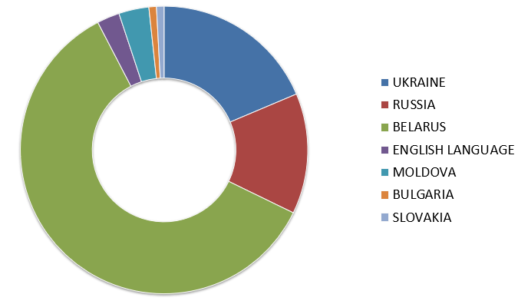
Source of Illegal Packs in 2011

Slide 21
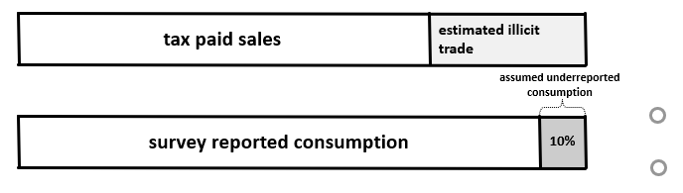
Gap Analysis
    Survey data capture the total market, not just legal market
    If we know the size of the legal market, we can calculate the size of the illegal market
    When to use: available reliable and consistent estimates of tobacco consumption over time and unbiased records of tax-paid sales during the same period

Slide 22
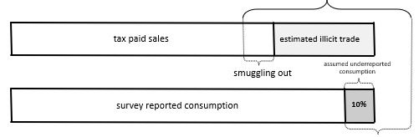
Gap Analysis (continued)
    Illicit export and higher rate of underreporting would increase the estimate of the size of illicit trade.
    If these are not taken into account, the estimates of tax avoidance and tax evasion are conservative.

Slide 23
Gap Analysis
    Steps:
    Obtain several years of reliable data on physical quantities of tax paid sales
    Obtain data on cigarette consumption from national representative surveys for the same years (account for non-daily smokers and young smokers if they are reported separately)
    Estimate smoking intensity for adults and the youth
    Multiply the smoking population by smoking intensity
    Compare the tax paid sales with the estimated consumption and study how the gap evolved over time

Slide 24
Gap Method in the UK,
2000 - 2013
Source: Tobacco smuggling. First Report of Session 2014–15.
Home Affairs Committee, House of Commons, HC 200, UK, 14 June 2014.

Slide 25
Gap Analysis (continued)
  Advantages:
  Transparency, replicability, and low costs.
  This is one of the few methods that captures illicit domestic production
  Disadvantages:
  People may not report correctly their consumption
  Surveys may not be representative
  It is better in measuring any deviation from the trend; may not provide the accurate scope.
  Cannot distinguish between tax avoidance and tax evasion

Slide 26
Which Methods to Avoid
  Key informant interviews (WB) – can obtain background information, but potentially very biased.
  Monitoring tobacco trade (WB) – the quality of data, and seasonality is the main issue.
  Analyzing seizures of illegally transported tobacco – need to control for the level of effort; data needed for long period to control for probability of detection

Slide 27
Methods – Summary
  No single method will produce a definitive answer because each has pluses and minuses
  Weakness of a particular approach can be exacerbated by specific market conditions, so it is important to use local specific knowledge and creativity when applying these methods.
  It is important to triangulate the estimates of the scope of the problem using different methods
  Many studies apply the same method over time to capture changes in the scope of tax avoidance/evasion rather than generating a single point estimate (addresses methods’ weaknesses, evaluates the impact of policies and other factors)

Slide 29
Hana Ross
hzarub1@yahoo.com

