Slide 1

Towards Resilient Futures Community of Practice: Phase II
The Biorefinery as a Pathway to Building Economic Complexity in the Post-Mine Landscape
Shilpa Rumjeet (CeBER) and Francois Steenkamp (DPRU)
November 2021, Cape Town

Slide 2

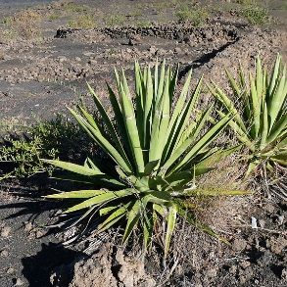
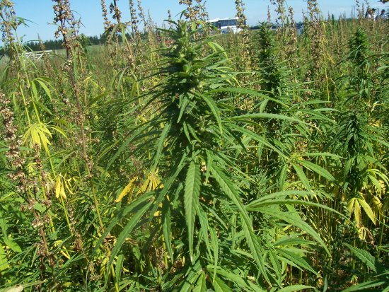
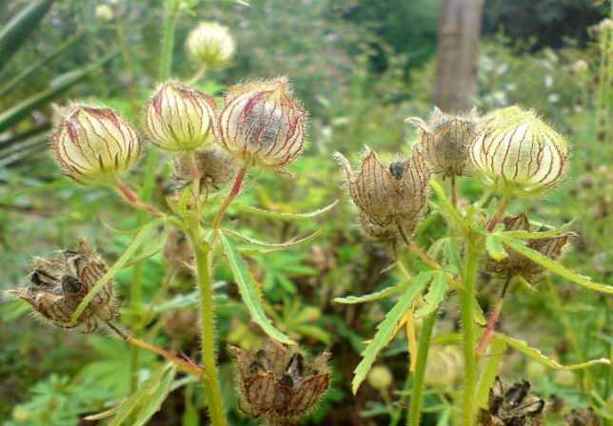
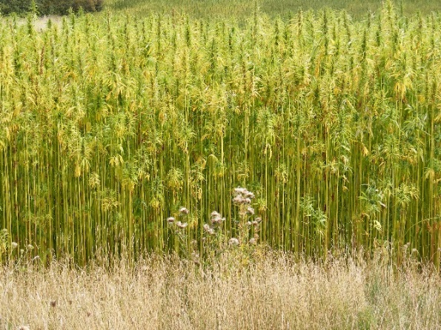
CoP: Phase I
______________________________

Slide 3

The case of fibrous plants
Land remediation potential
Metal recovery potential
Fibre-derived products
Cultivation
Plants processing
Fibre processing
Lead products
Harvested
Fibres
Plants
Proposed lead fibre products:
Bamboo: wood-based products
Hemp & Kenaf: Biocomposites
Proposed plants:
Bamboo (Bambusa Balcooa, Dendrocalamus asper)
Flax
Hemp
Kenaf
Sisal
Metal processing
Metals
The extent of pollution of the sites considered for combined remediation and multi-product development is a key factor in expected performance.

Slide 4

Availability of residual biomass
30 % w/w¹
Bast Fibre (towards lead fibre products
Seeds
Stem
Bast fibre losses during processing and/or low quality bast fibres
&
Woody tissue/core fibre
Fibre losses: ~ 1 -2 metric ton/ha³
70 % w/w
~ 2 – 15 metric ton/ha²
Lignocellulosic biomass
Leaves
Leaves
~ 12 metric tonne/ha⁴
Chemical extracts
Seeds
or
Stem
~ 200 – 500 kg/ha⁵
¹Stevulova et al. (2014)
²Duque Schumacher et al. (2020)
^{3,4}USDA (1998)
⁵Russell et al. (2015)
Whole seed
Bast fibre plant e.g. hemp
Part of plant
Raw material/feedstock for further processing

Slide 5
CoP: Phase II Paper 1
______________________________

Slide 6
Extending benefits – The Biorefinery Concept
Cultivation
Plants processing
Fibre processing
Harvested
Fibres
Lead products
Plants
By-products e.g. residual biomass, wastewater
Metal processing
Metals
Fuelling a multi-product value chain by maximising resource efficiency
By-products e.g. residual biomass, wastewater
Bioproducts
Biorefinery
Energy products
Fit-for-purpose water

Slide 7


A cross-disciplinary research process
Stage 1: Identify biorefinery products that can be made from residual biomass (CeBER + M2M)
Stage 2: Map biorefinery products to trade data (CeBER + DPRU)
Stage 3: Run frontier product approach to identify biorefinery products that are both feasible (distance/density) and desirable (complexity) (DPRU)
Stage 4: Select set of frontier product clusters and conduct techno-economic assessment of product clusters (CeBER + DPRU)
Stage 5: Legal/regulatory case study (post-workshop) (CeBER + DPRU + MLiA)
Notes:
Present this slide as a pathway to our discussion

Slide 8
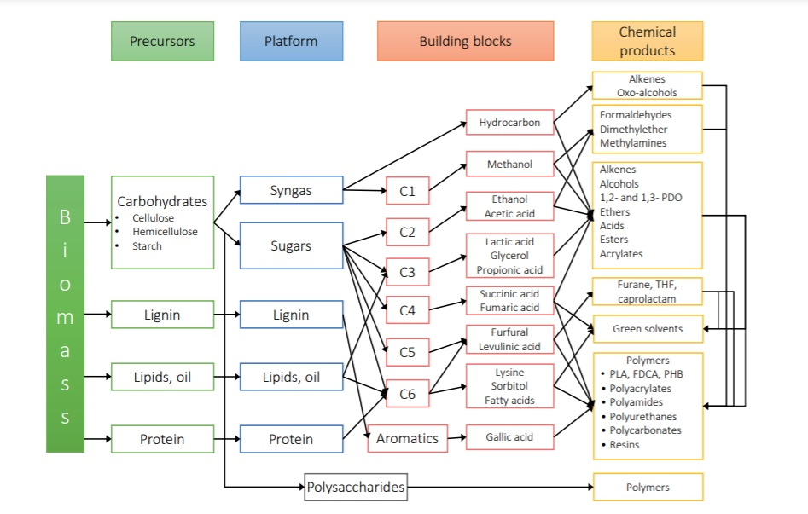
Stage 1: Biorefinery products identification
Resource-efficiency, technical and economical feasibility are key indicators for the success of a biorefinery, underpinned by environmental and societal benefits.
Depending on the biomass characteristics and ease of processing, a mix of high-value products, energy products and low-value biomass products is possible.
(Abdilla – Santes, 2020)
A biorefinery is a facility that integrates biomass conversion processes and equipment to produce fuels, power, and chemicals from biomass

Slide 9
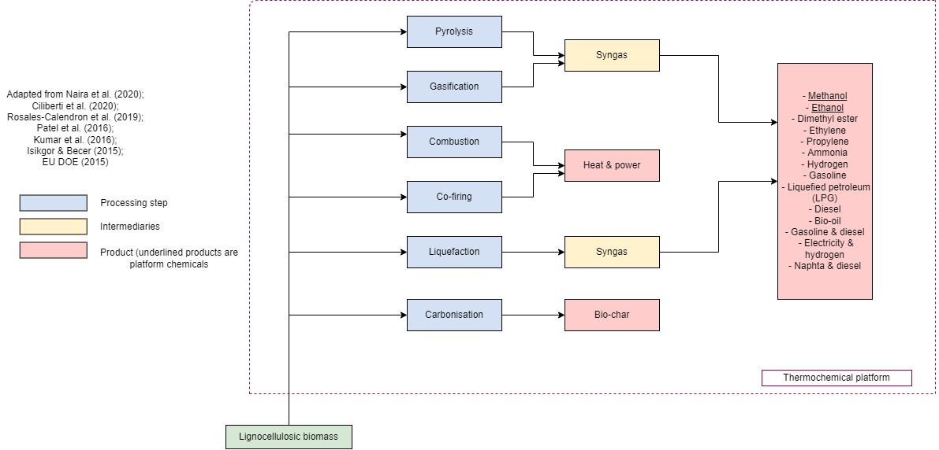
Stage 1: Analysis of thermochemical (syngas) platform
*A platform chemical is defined as a chemical that can serve as a raw material for the production of various other higher value-added products
Notes:
Syngas: carbon monoxide (CO) and hydrogen (H₂) ( sometimes some carbon dioxide – CO₂)

Slide 10
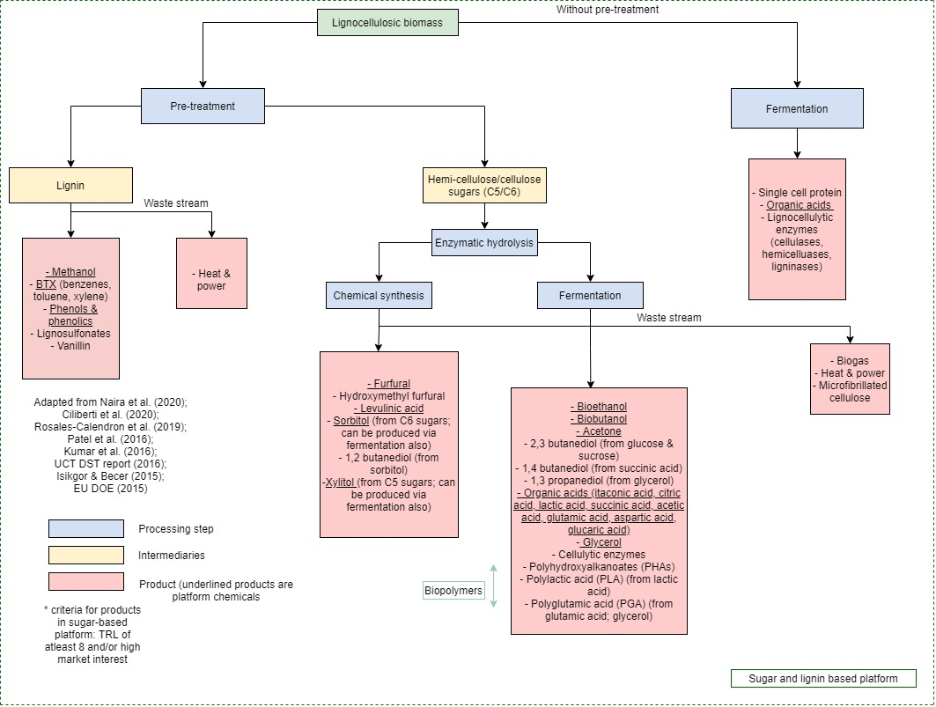
Stage 1:
Analysis of sugar and lignin platform

Slide 11
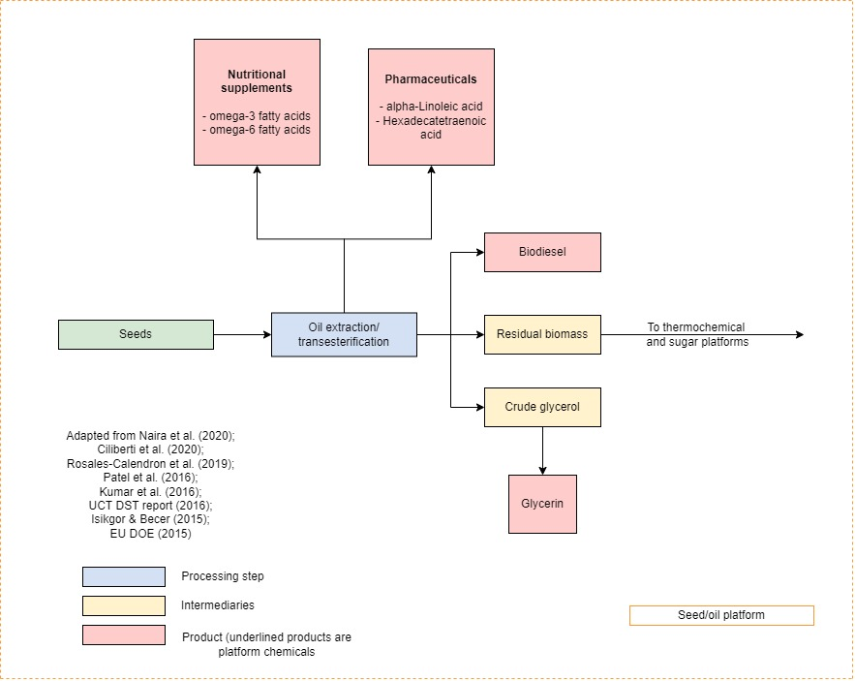
Stage 1:
Analysis of seed/oil platform

Slide 12
Stage 2: Mapping biorefinery products to trade data
Identified 60 biorefinery products, which were classified according to their platform into:
High-value bioproducts (24) (see left)
Energy products (12)
Low-value biomass products (23)
High-value bio-polymers (1)
Iterative cross-disciplinary mapping process
Benefit – able to map products – organic chemistry outside skill set of economists
Challenges – for Energy products, hard to distinguish between bio-based versus mineral-based
Notes:
Drawing from Stage 1, we now have a list of products that can be manufactured in a biorefinery.
Stage 2 involves the mapping of the biorefinery products to the trade data used to generate the complexity and industrial relatedness metrics that will provide a data-centric lens to inform which biorefinery products offer the most economic potential

Slide 13
Stage 3
_________________________________________________
Identifying Frontier Biorefinery Products
Using Economic Complexity and Industrial Relatedness metrics to inform industrial policy in a data-centric manner
Notes:
To identify frontier biorefinery products – those that are most feasible, in terms of having the capabilities to produce, and most desirable, in terms of growth potential – we consult two literatures:
Economic complexity
industrial relatedness
The ideas and metrics that emerge from these literatures inform industrial policy type questions in a data centric manner

Slide 14
Economic Complexity
Economic complexity metrics indirectly measure:
the presence of productive capabilities, and hence, the productive capacity of an economy,
by using information on the diversity and ubiquity of an economy’s productive structure
Stylized Facts:
ECI is positively correlated with economic development
ECI is a significant predictor of long-term economic growth
See Hidalgo & Hausmann, 2009; Hausmann et al., 2014; Chavez et al., 2017; Christelli et al., 2015
Source: Own calculations using trade data from BACI data (HS 6-digit revision 1992) and GDP per capita data from the World Development Indicators.
Notes: The sample of countries is reduced to those for which we estimate complexity measures.
Building economic complexity allows an economy to graduate to higher levels of economic development
Notes:
Measurement:
Economic complexity metrics measure economic capacity using methods that are related to dimensionality reduction
The dimensionality reduction technique summarises the vectors that best explain the geography of thousands of economy activities – can be done using exports data, patent data, occupation data, industrial data
Two important concepts:
Diversity: how diverse is the export portfolio of the country?
Ubiquity: how commonly produced is a particular product?
Notion of economic complexity combines these concepts:
More complex country = higher diversity of less ubiquitous products
Less complex country = lower diversity of more ubiquitous products
Stylized facts:
ECI is positively correlated with economic development
After controlling for each country’s natural resource exports, ECI and natural resource exports explain 73% of variation in GDP p.c. across countries.
ECI is a significant predictor of long-term economic growth
Variation from regression line informs potential for growth: if you are below regression line, then your complexity is high for your level of GDP per capita, thus, there is high potential for future growth in the economy. (Talk about GRC and IND … v similar ECI – Greece is above, so is less complex than it should be given GDP -> fewer opportunities for future growth; IND is below so is more complex than its GDP suggests it should be-> more opportunities for growth)
See Hidalgo & Hausmann, 2009; Hausmann et al., 2014; Chavez et al., 2017; Christelli et al., 2015

Slide 15
Industrial Relatedness
The success of a location entering an economic activity depends on cognitive and technological proximity between the new activity and a location’s prior activities.
Relatedness is indirectly measured by looking at the collocation of activities within and across locations.
Distance index
Stylized Facts:
Relatedness predicts the activities (products) that a location (country) will enter or exit in the future (Hidalgo et al., 2007; Neffke & Henning, 2013)
Structural transformation is a path dependent process (Hausmann et al., 2014)
Measures of industrial relatedness allow one to identify feasible diversification opportunities
Notes:
Building economic complexity involves the diversification of an economy toward increasingly complex products (akin to the process of structural transformation)
The industrial relatedness literature speaks to how this happens
Relatedness:
Based on the idea of absorptive capacity – the notion that a firm’s ability to absorb new knowledge is a function of its prior level of related knowledge
Thus, the success of a country/region entering an economic activity depends not only on geographical and cultural forms of proximity (distance or language), but on cognitive and technological proximity between the new activity and a region’s prior activity
Related activities are neither exactly the same nor completely different – 1) not competing activities, 2) spillovers ito knowledge, inputs and routines between activities
Relatedness metric:
Relatedness (density) looks at the number of similar activities thar are present in a location
Collocation of activities, using metrics such as the minimum conditional probability
Distance Index – distance of a product from a location’s current productive knowledge or capabilties

Slide 16
Frontier Product Approach: Data-Centric Lens to Inform Industrial Policy
Complexity methods help characterize detailed economic structures and provide a quantitative basis for industrial policy efforts:
EUs Smart Specialisation Strategy (Balland et al., 2018)
Mexico’s Smart Diversification Strategy
Canada’s Supercluster Initiative
China’s Special Economic Zones (De Waldemar & Poncet, 2013)
Desirability
Feasibility
Notes:
Complexity methods help characterize detailed economic structures and provide and quantitative base for industrial policy efforts, for example:
Europe’s Smart specialization strategy (Balland, Boschma, Crespo & Rigby (2018)
China’s special economic zones (De Waldemar & Poncet, 2018)
Mexico’s Smart Diversification Strategy
Canada’s Supercluster Initiative

Slide 17
Frontier Product Approach: Complexity Criterion
Frontier Product Approach A:
Follows Hausmann & Chauvin (2015)
Desirability criteria
Product Complexity Index (PCI) > Economic Complexity Index (ECI)
Opportunity Gain Index > 0
Feasibility criteria
Distance Index < median distance of non-RCA products
Frontier Product Approach B:
Follows Hausmann, Cunningham, Matovu, Osire & Wyett (2014)
Desirability criteria
Product Complexity Index (PCI) > Economic Complexity Index (ECI)
Opportunity Gain Index > 0
Feasibility criteria
Take into account the trade-off between PCI and Distance and include products that are distant only if they are correspondingly complex
The gain in complexity compensates for the substantial investment in productive capabilities needed to overcome the distance gap
Notes:
The use of complexity and industrial relatedness metrics, provides a data-centric approach to informing our decision on what biorefinery products to manufacture.
It is worth noting that this is an initial step that requires subsequent investigation and validation – ideally drawing on a multi-disciplinary team.
The focus is on diversification and thus entry (expansion) of products that SA does not produce and export competitively (i.e. non-RCA products)
Approach B – the gain in complexity compensates for the substantia investment in productive capabilities needed to overcome the distance gap

Slide 18
Frontier Biorefinery Products: Complexity Criterion
 |  | A | B
Total Biorefinery Products |  | 60 | 60
RCA |  | 14 | 14
Non-RCA | Frontier | 18 | 22
 | Not Frontier | 28 | 24
Frontier biorefinery products (red) are a mix of high value platform chemicals (9), low-value biomass products (6) and energy products (3)
Approach B identifies some frontier products where the distance gap could be compensated for by the substantial gain in complexity (risk versus reward)
  High value platform chemicals and bioplastics
Notes:
RCA products:
Energy: Biogas, Butanol, Naphtha and diesel, Wood charcoal
High-value: Phenols, Acetone, Furfural
Low value biomass: Residue of biomass (ash), Residue of biomass (fertilizer), Residue of biomass (ethers, tannins), Lignosulphonates
Non-Frontier:
Some meet the distance threshold but not the complexity threshold - typically low-value biomass products
Some meet complexity threshold but beyond distance threshold – typically high value platform chemicals

Slide 19
Frontier Biorefinery Products: Additional Criterion
We can add additional criteria to further inform our decisions:
Technological intensity:
The ability of a country to incorporate technology intensive production activities is a key factor to its future growth prospects (Lall, 2000)
Demand:
Target growing global markets
Notes:
We can add further criteria to provide additional lenses to inform our decisions. These can include:
Technological intensity
MT and HT versus RB, LT and PP
High-value platform chemicals (Glycerol; Acetic acid, Polylactic acid, Methanol, Ethanol, Sorbitol, Lactic acid etc.)
Bio-plastics (Polyglutamic acid)
Demand
AAGR for product > AAGR for global trade BUT, could apply more detailed cut-offs
E.g. Xylene
Green products
Mealy & Teytelboym (2020) compile a consensus-driven list of green trade products, and find these products to be characterised by higher levels of complexity.
Rich countries have higher Green Complexity Index (avg. PCI of green products in export structure)
Not many green products in our list – only ammonia, methanol and residue of biomass
Caution: the classification does not take into account how a product is made.

Slide 20
Economic Complexity and Inequality
Hartman et al. (2017) show that complex economies are more inclusive. These economies are more inclusive because:
Require networks of skilled workers, interactive learning, and inclusive institutions
More job opportunities and bargaining power of workers
Better distribution of political and economic power
Hartman et al. (2017) generate product level Gini measures – Product Gini Index (PGI)
Associates a product to a level of income inequality equal to the average Gini of the countries exporting that product
This product-level measure of inclusiveness allows one to introduce a socio-economic lens to the frontier product approach
Notes:
Recent work by Dominik Hartman, allows one to introduce a socio-economic lens into the frontier product approach.
Hartman et al. (2017) show a robust negative relationship between economic complexity (ECI) and income inequality (Gini)

Slide 21
Frontier Biorefinery Products: Socio-Economic Criterion
Set cut-off as South Africa’s XGINI – the Gini index associated with its export structure (45.2)
Diversification into frontier products will promote inclusive growth
Notes:
Cut-off – South Africa’s XGINI index
Most products fall under the threshold because PGI is highly correlated with PCI and manufactured products, such as chemicals are associated with higher levels of PCI
Moving Forward:
The frontier product approach provides an initial data-centric view into what biorefinery products offer the greatest potential in terms of desirability and feasibility
The next step in the research process is to conduct further techno-economic analysis of multi-product clusters that can potentially emerge from the biorefinery

Slide 22
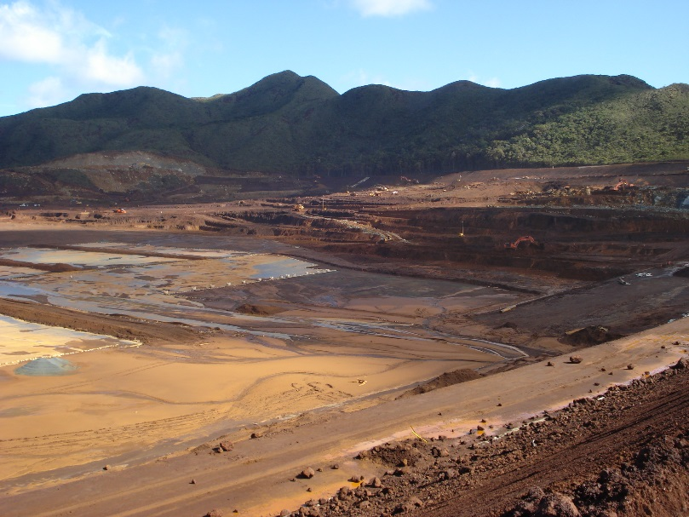


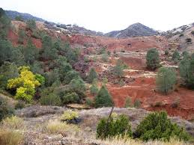
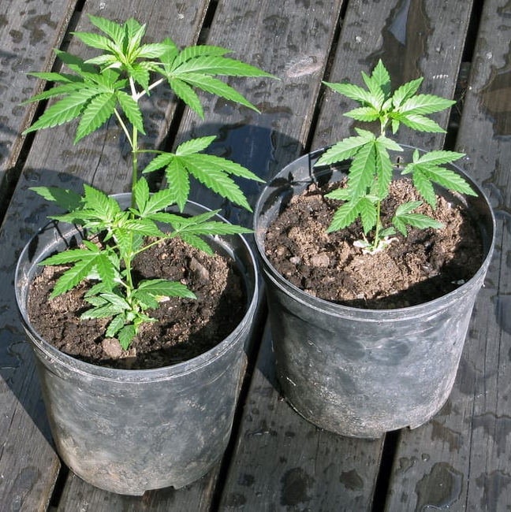
Stage 4 & Stage 5
_________________________________________________
Ongoing & future work

Slide 23
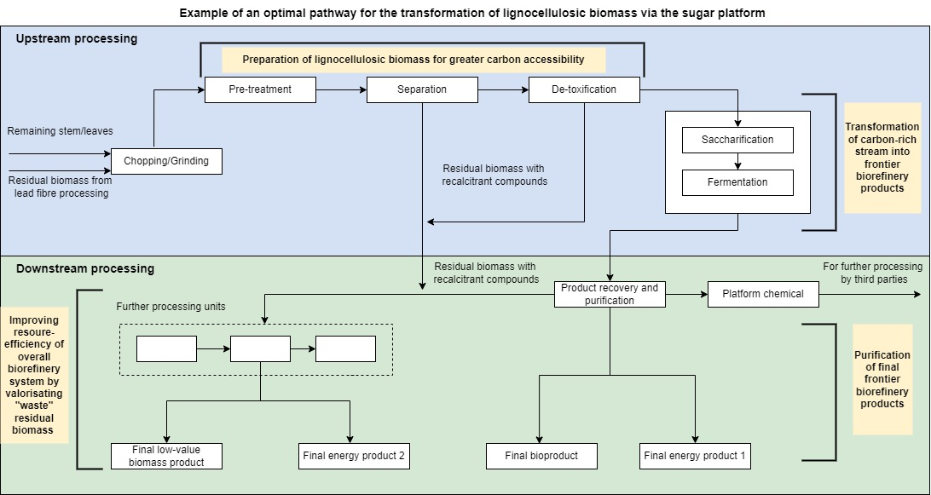
Stage 4: Product clusters for a flexible multi-product biorefinery
Technical limitations:
Metal contamination in residual biomass and its influence on product formation
Balance between lead fibre products and biorefinery products
Water and energy demands of biorefinery units, together with GHG emissions
Notes:
This is an example of a pathway for the transformation of lignocellulosic biomass via the sugar platform. As you can see there are multiple units in a biorefinery and in our particular there are four main sections, for example (…) Thus, by producing several products, a biorefinery takes advantage of the various components in biomass and their intermediates, therefore maximizing the value derived from the biomass feedstock. In Stage 4 we will focusing on a few different product clusters and investigate their feasibility and techno-economics. However, we anticipate to be limited by a few factors..

Slide 24
Potential Impacts of Alternative Biorefinery Cluster Scenarios
One can compare the potential economic outcomes of various multi-product cluster scenarios that could emerge from the biorefinery concept.
 |  |  | Frontier |  | RCA
 |  |  | A | B
Cluster 1 | Bioethanol | High-value platform chemical | 0 | 1 | 0
 | Biodiesel | Energy product | 1 | 1 | 0
 | Biogas | Energy product | 0 | 0 | 1
 | Fertiliser | Low-value biomass product | 0 | 0 | 1
 | Peat | Energy product | 1 | 0 | 0
Cluster 2 | Bioethanol | High-value platform chemical | 0 | 1 | 0
 | Polylactic Acid | High-value platform chemical | 1 | 1 | 0
 | Biogas | Energy product | 0 | 0 | 1
 | Fertiliser | Low-value biomass product | 0 | 0 | 1
 | Peat | Energy product | 1 | 0 | 0
Notes:
One can evaluate how the emergence of various multi-product cluster scenarios from the biorefinery impact of average PCI and PGI
One needs to assume that the country can achieve RCA in these frontier products

Slide 25
Concluding Remarks
We have extended the CoP’s investigation into creating vibrant post-mine economies through the cultivation and processing of fibrous plants, by exploring the biorefinery concept. Key to this concept is the fuelling of a multi-product value chain by maximising resource efficiency
We have identified biorefinery products that can be manufactured using residual biomass from fibrous plants, post-fibre extraction
Applying economic complexity and industrial relatedness theory and metrics, we have identified biorefinery products that are both feasible, given existing productive capabilities, and offer growth potential.
  We have also offered additional lenses from which to inform product selection decisions
  Data centric approach to inform industrial policy questions
This has been driven by an iterative and integrated cross-disciplinary approach
Future work
  Stage 4 – continue analysing techno-economic feasibility of multi-product biorefinery clusters
  Stage 5 – incorporating a regulatory perspective to the biorefinery concept

Slide 26
References
Abdilla-Santes, R. (2020) University of Groningen Alternative Sugar Sources for Biobased Chemicals. University of Groningen. doi: 10.33612/diss.127600956.
Balland, P.A., Boschma, R., Crespo, J. and Rigby, D.L. (2019) Smart specialization policy in the European Union: relatedness, knowledge complexity and regional diversification. Regional Studies. 53(9): 1252-1268.
Chávez, J. C., Mosqueda, M. T. and Gōmez-Zaldívar, M. (2017) Economic complexity and regional growth performance: Evidence from the Mexican economy. Review of Regional Studies. 47: 201-219.
Christelli, M., Tacchella, A. and Pietronero, L. (2015) The heterogeneous dynamics of economic complexity. PLoS ONE 10(2):e0117174.
Ciliberti, C., Biundo, A., Albergo, R., Agrimi, G., Braccio, G., de Bari, I. and Pisano, I. (2020) ‘Syngas derived from lignocellulosic biomass gasification as an alternative resource for innovative bioprocesses’, Processes, 8(12), pp. 1–38. doi: 10.3390/pr8121567.
Duque Schumacher, A. G., Pequito, S. and Pazour, J. (2020) ‘Industrial hemp fiber: A sustainable and economical alternative to cotton’, Journal of Cleaner Production, 268(May). doi: 10.1016/j.jclepro.2020.122180.
Harrison, S., Rumjeet, S., Mabasa, X. and Verster, B. (2019) Towards Resilient Futures: Can fibre-rich plants serve the joint role of remediation of degraded mine land and fuelling of a multi-product value chain? Cape Town: UCT. Available at: http://www.resilientfutures.uct.ac.za/sites/default/files/image_tool/images/479/Outputs/CeBER_CoP WP.pdf.
Harrison, S. T. L. et al. (2016) ‘Feasibility study: Bio-based chemicals landscape of South Africa’.
Hartmann, D., Guevara, M.R., Jara-Figueroa, C., Aristarán, M. and Hidalgo, C.A. (2017) Linking economic complexity, institutions, and income inequality. World development. 93: 75-93.
Hausmann, R. et al. (2014) The Atlas of Economic Complexity: Mapping Paths to Prosperity. MIT Press.
Hausmann, R. and Chauvin, J. (2015) Moving to the adjacent possible: Discovering paths for export diversification in Rwanda. CID Working Paper Series.
Hausmann, R., Cunningham, B., Matovu, J., Osire, R. and Wyett, K. (2014) How should Uganda grow?. CID Working Paper Series.
Hidalgo, C.A., Klinger, B., Barabási, A.L. and Hausmann, R. (2007) The product space conditions the development of nations. Science. 317(5837): 482-487.
Hidalgo, C.A. and Hausmann, R. (2009). The building blocks of economic complexity. Proceedings of the national academy of sciences. 106(26): 10570-10575.
Isikgor, F. H. and Becer, C. R. (2015) ‘Lignocellulosic biomass: a sustainable platform for the production of bio-based chemicals and polymers’, Polymer Chemistry. Royal Society of Chemistry, 6(25), pp. 4497–4559. doi: 10.1039/c5py00263j.
Kumar, A., Gautam, A. and Dutt, D. (2016) ‘Biotechnological Transformation of Lignocellulosic Biomass into Industrial Products: An Overview’, Advances in Bioscience and Biotechnology, 07(03), pp. 149–168. doi: 10.4236/abb.2016.73014.

Slide 27
References
Lall, S. (2000.)The Technological structure and performance of developing country manufactured exports, 1985‐98. Oxford development studies. 28(3): 337-369.
Mealy, P. and Teytelboym, A. (2020) Economic complexity and the green economy. Research Policy: 103948.
Naira, V. R., Mahesh, R., Panda, S. K. and Maiti, S. K. (2020) ‘Biorefinery Approaches for the Production of Fuels and Chemicals from Lignocellulosic and Algal Feedstocks’, Biorefinery of Alternative Resources: Targeting Green Fuels and Platform Chemicals. Springer, Singapore, pp. 141–170. doi: 10.1007/978-981-15-1804-1_7.
Neffke, F. and Henning, M. (2013) Skill relatedness and firm diversification. Strategic Management Journal, 34(3): 297-316.
Patel, M., Zhang, X. and Kumar, A. (2016) ‘Techno-economic and life cycle assessment on lignocellulosic biomass thermochemical conversion technologies: A review’, Renewable and Sustainable Energy Reviews. Elsevier, 53, pp. 1486–1499. doi: 10.1016/j.rser.2015.09.070.
Poncet, S. and De Waldemar, F.S. (2015) Product relatedness and firm exports in China. The World Bank Economic Review. 29(3): 579-605.
Rosales-Calderon, O. and Arantes, V. (2019) A review on commercial-scale high-value products that can be produced alongside cellulosic ethanol, Biotechnology for Biofuels. BioMed Central. doi: 10.1186/s13068-019-1529-1.
Russell, J., Dalsted, N., Tranel, J. E. and Young, R. B. (2015) ‘Industrial Hemp’, Agriculture & Business Management, (October), pp. 1–7. doi: 10.1016/j.jcp.2004.11.003.
Stevulova, N., Cigasova, J., Estokova, A., Terpakova, E., Geffert, A., Kacik, F., Singovszka, E. and Holub, M. (2014) ‘Properties characterization of chemically modified hemp hurds’, Materials, 7(12), pp. 8131–8150. doi: 10.3390/ma7128131.
USDA (1998) Harvesting, Retting, and Fiber Separation Retting, Industrial Hemp in the United States.
Verster, B., Young, C., Steenkamp, F., Broadhurst, J. L. and Harrison, S. . (2018) Mine closures: Addressing the fallout, University of Cape Town. Available at: https://www.news.uct.ac.za/article/-2018-07-16-mine-closures-addressing-the-fallout (Accessed: 3 October 2019).
van Zyl, G. (2018) Carletonville’s Gold Street: Where SA’s mining history goes to die a slow death - BizNews.com, BizNews. Available at: https://www.biznews.com/sa-investing/2018/06/20/carletonville-gold-street-sa-mining-history-die-slow-death (Accessed: 14 October 2019).

Slide 28





http://www.resilientfutures.uct.ac.za/about-Towards-Resilient-Futures

