Slide 1
Community of Practice:
Towards Resilient Futures
The Economic Opportunities of Plant Biomass
Presented by: François Steenkamp
With: Haroon Bhorat, Mumbi Kimani, Safia Khan,
Christopher Rooney & Toughedah Jacobs
Development Policy Research Unit, University of Cape Town
28 May 2018

Slide 2
Outline
Tools and methods
  Economic Complexity
  The Product Space – growing complexity
Answering the Key Research Question

Slide 3
Tools & Methods: Economic Complexity
The Economic Complexity and Product Space analytical framework, developed by Ricardo Hausmann, Cesar Hidalgo and a team of researchers at the Centre of International Development, Harvard University, poses an alternative way of thinking about economic development.
The methodology is relatively new in the field of economics, and represents a shift in thinking about development along the following lines:
Aggregate (e.g. GDP) → granular (e.g. products).
Combining factors of production → Combining productive capabilities or productive know-how.
Division of labour → division of knowledge or know-how.
Two key analytical ideas:
  Economic Complexity
  The Product Space

Slide 4
Tools & Methods: Economic Complexity
The Notion of Economic Complexity (Hausmann et al., 2011)
The process of economic development is about the accumulation of productive capabilities that allow a country to produce a diversity of increasingly complex products.
Hidalgo et al. (2009) describes these productive capabilities as non-tradable networks of collective know-how, such as logistics networks, finance networks, supply networks, and knowledge networks.
The Economic complexity index (ECI) is calculated by using information on 1) diversity of a country’s export portfolio, and the 2) ubiquity of the products that it exports.
  Greater diversity of products = more capabilities (more complex)
  Scarce products = more specialised capabilities (more complex)

Slide 5
Economic Complexity – e.g. thinking about capabilities
Notes:
Knowledge is embedded across many individuals and is brought together by markets

Slide 6
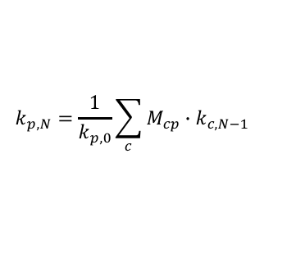

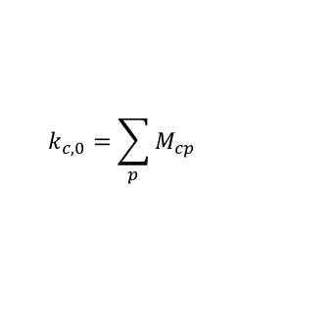
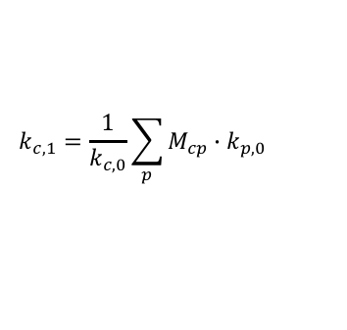



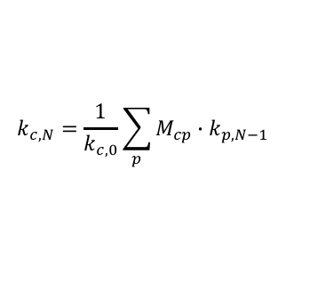



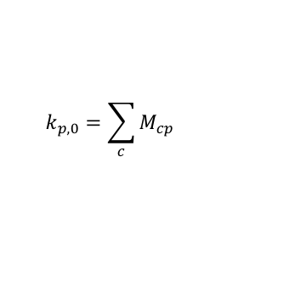
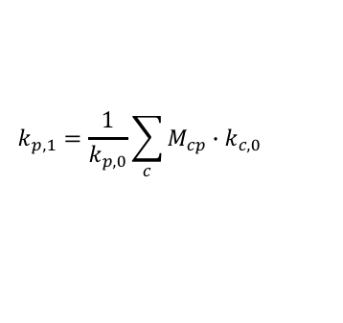

Tools & Methods: Economic Complexity
$$k_{c,N}=\frac{1}{k_{c,0}}\sum_{p}{M_{cp}∙k_{p,N−1}}$$
1st reflection
$$k_{p,N}=\frac{1}{k_{p,0}}\sum_{c}{M_{cp}∙k_{c,N−1}}$$
$$k_{c,1}=\frac{1}{k_{c,0}}\sum_{p}{M_{cp}∙k_{p,0}}$$
$$k_{c,0}=\sum_{p}{M_{cp}}$$
$$k_{p,0}=\sum_{c}{M_{cp}}$$
$$k_{p,1}=\frac{1}{k_{p,0}}\sum_{c}{M_{cp}∙k_{c,0}}$$
$k_{c1,1}=(\frac{1}{4})(1+2+2+3)$=2
$k_{p1,1}=(\frac{1}{1})(4)$=4
$$k_{c2,1}=\left(\frac{1}{1}\right)\left(2\right)=2$$
$$k_{p2,1}=\left(\frac{1}{2}\right)\left(4+1\right)=2.5$$
$$k_{c3,1}=\left(\frac{1}{2}\right)\left(2+3\right)=2.5$$
$$k_{p3,1}=\left(\frac{1}{2}\right)\left(4+2\right)=3$$
$$k_{c4,1}=\left(\frac{1}{1}\right)\left(3\right)=3$$
$$k_{p4,1}=\left(\frac{1}{3}\right)\left(4+2+1\right)=2.33$$
Avg. ubiquity of products exported by country c
Avg. diversity of countries exporting product p
Notes:
Calculating higher reflections of the method (or iterations)
Diversity – more capabilities – more complex
Ubiquity – less capabilities – less complex
Itterations correct information – e.g. next slide – diversity to avg. ubiquity of products that country c exports

Slide 7
Tools & Methods: Economic Complexity
PAK vs. CHE
Notes:
Same diversity but different avg. ubiquity of products exported

Slide 8
Economic Complexity –Is it useful?
Economic Complexity and GDP per capita, 2014
Notes:
E.g. Japan and Germany versus Angola, Nigeria, Malawi
ECI correlated with GDP per capita
ECI able to predict future growth

Slide 9
The Product Space – Growing Complexity
The process of economic development is about the accumulation of productive capabilities that allow a country to produce a diversity of increasingly complex products.
Therefore, accumulate new capabilities and produce a greater diversify of products.
BUT, the chicken and egg problem…
How do countries accumulate capabilities, and thus produce the new products that require such capabilities ?
Countries are more likely to move into products that can make use of capabilities that the country already has and is using in existing industries
This implies that countries will diversify by moving from the industries that already exist, to others that require a similar set of capabilities
  i.e. it is easier to shift from shirts to blouses than from shirts to jet engines.
Notes:
You can’t produce products that require capabilities that you do not have.
BUT, there is no incentive to accumulate capabilities if the industries that demand them, do not exist.

Slide 10
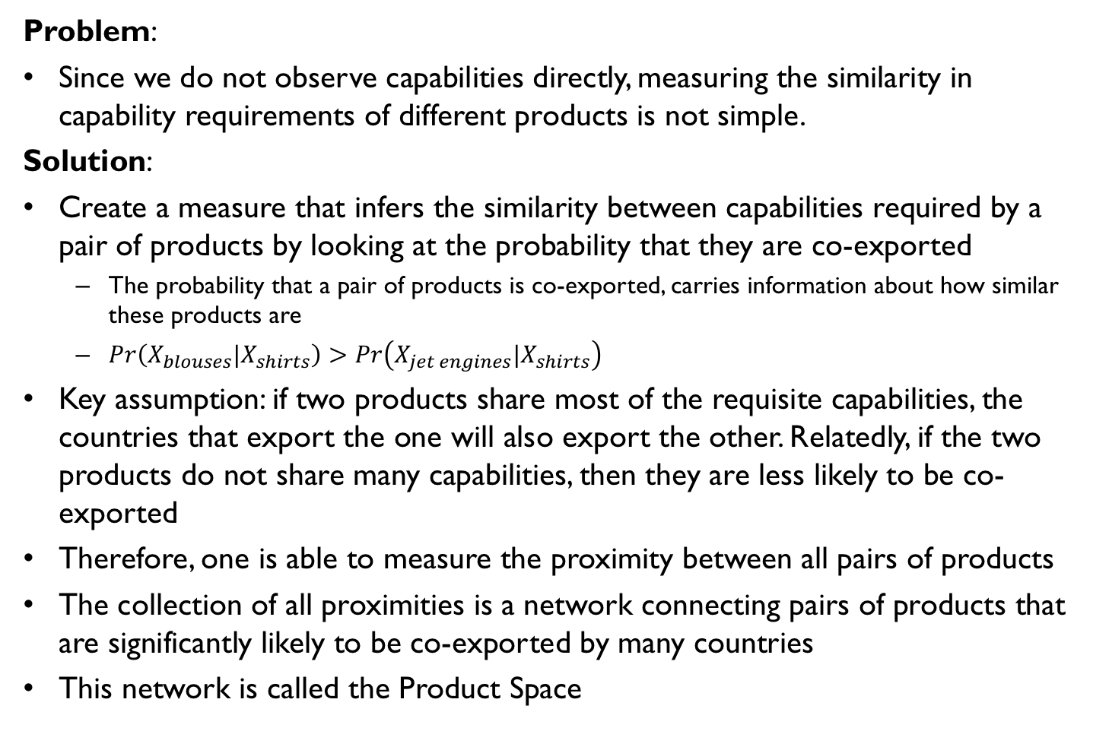
The Product Space – Growing Complexity
Problem:
Since we do not observe capabilities directly, measuring the similarity in capability requirements of different products is not simple.
Solution:
Create a measure that infers the similarity between capabilities required by a pair of products by looking at the probability that they are co-exported
  The probability that a pair of products is co-exported, carries information about how similar these products are
  $Pr\left(X_{blouses}|X_{shirts}\right)>Pr\left(X_{jet engines}|X_{shirts}\right)$
Key assumption: if two products share most of the requisite capabilities, the countries that export the one will also export the other. Relatedly, if the two products do not share many capabilities, then they are less likely to be co-exported
Therefore, one is able to measure the proximity between all pairs of products
The collection of all proximities is a network connecting pairs of products that are significantly likely to be co-exported by many countries
This network is called the Product Space
Notes:
You can’t produce products that require capabilities that you do not have.
BUT, there is no incentive to accumulate capabilities if the industries that demand them, do not exist.

Slide 11
Visualising the Product Space
Notes:
Node: each point is a node and is scaled by size of product in world trade. Colour of nodes indicative of community (i.e. similar set of capabilities – similar PCI)
Links/Edge: Connect products with a high probability of being co-exported (thicker and darker link – higher probability of being co-exported)
Generate a ‘maximum spanning tree’ – create a connected network with no isolated islands of products. MST is a set of N-1 links that connects all nodes in the network and maximises the sum of proximities in it.
Also include strongest links which are not in the MST – links above a certain proximity threshold. Strongest 1% of links – ensure that the visualisation is sparse an not too much visual complexity
Use force-directed layout algorithm – densely connected nodes are put together and nodes that are not connected are pushed apart.
The product space is heterogeneous – some sections are dense and connected while other sections are sparse and peripheral
This has implications on 1) ability to grow in complexity and 2) undergo structural transformation
Product space show many products that are grouped into highly connected communities communities (e.g. chemicals, machinery, electronics, clothing) – communities use similar set of capabilities

Slide 12
The Product Space – Growing Complexity
Two implications of interest:
Implication 1: Manufacturing (and agro-processing) has the potential to lead to more manufacturing
If you’re in the core its easier to move into other parts of the core
Implications 2: Structural transformation is path dependent – future production structure is influenced by current production structure.
Your current capabilities influence your future diversification options

Slide 13
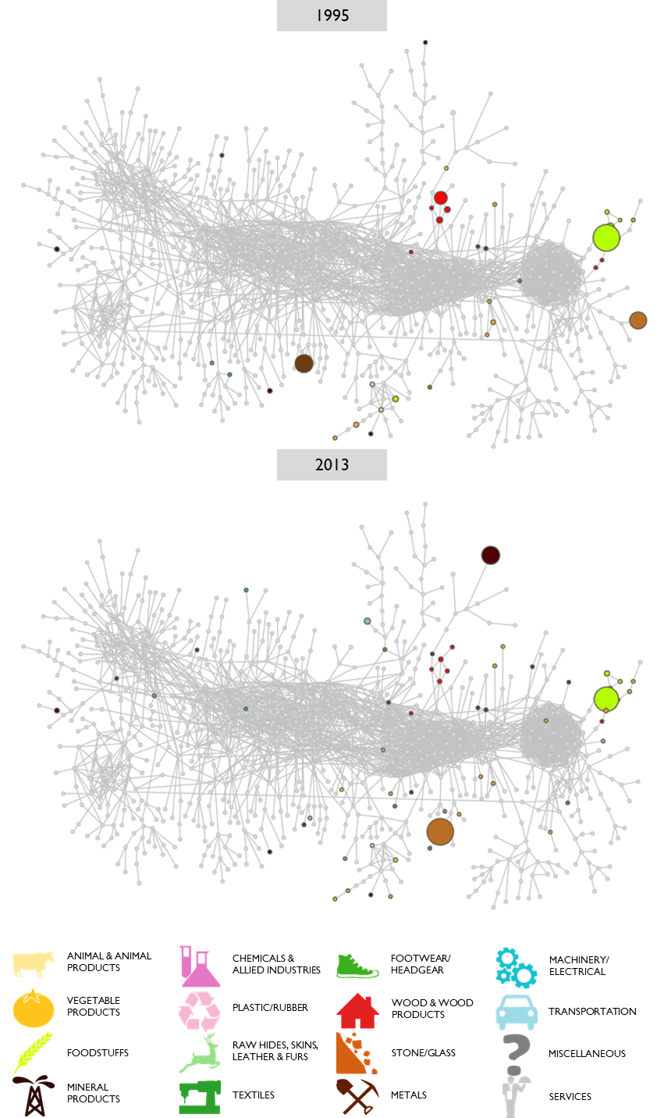
The Product Space – Growing Complexity
Implication 1: Manufacturing has the potential to lead to more manufacturing
The Product Space and Manufacturing
Graphical depiction of ‘distance’ between products.
Distance between A and B = measure of difference in productive capabilities needed to produce A and B.
Products in core (periphery) of product space manufactured (resource-based) products.
Distance between products within core (products ‘A’ and ‘B’) of product space < distance between core (Product A) & peripheral products (Product C).
2013
A
A
B
B
C

Slide 14


The Product Space – Growing Complexity
Product Space Analysis Nigeria, 1995 & 2013
Implication 1: Structural transformation is path dependent
Source: The Atlas of Economic Complexity," Centre for International Development at Harvard University, http://www.atlas.cid.harvard.edu

Slide 15
Product Space – Thailand (1975)
Natural rubber
Miscellaneous root & tuber vegetables
Refined sugars
Sugar cane
Maize
Garments
Cotton, rice, soy beans & others (e.g. milled rice)
Notes:
Natural resource intensive but with the emergence of clothing and textiles

Slide 16
Product Space – Thailand (1990)
Electronics (e.g. Computer peripherals; electronic microcircuits)
Fish & Seafood (e.g. crustaceans & moluscs)
Food processing (e.g. prepared fruit)
Machinery (e.g. Roller bearings, Miscellaneous rubber)
Construction materials & equipment (e.g. electric wire, furniture)
Garments and Textiles & Fabrics
Notes:
Significant shift toward relatively more complex industries – food processing, clothing and textiles, construction and furniture
Emergence of electronics and machinery and to a lesser extent chemicals

Slide 17
Product Space – Thailand (2014)
Electronics (e.g. Computer peripherals; electronic microcircuits)
Other Chemicals and Petrochemicals
Chemicals & Health related products (e.g. Cyclic hydrocarbons, Polymers)
Machinery (e.g. Trucks and vans, Vehicle Parts & Accesories)
Notes:
Complete shift to high complexity electronics, machinery and chemicals
Note: old resource-based industries remain but declining importance

Slide 18
What are the economic opportunities of plant biomass?
    Six step approach to answering our main research question:
    An analysis of the global and domestic market for fibrous plants:
      Analysis of industry level data at most disaggregated level available (e.g. size of furniture industry in terms of employment and GDP).
      Identification and analysis of product-level trade data pertaining to (bamboo) and (bamboo) related products (e.g. global market shares).
    Locate fibrous plants related products in the Product Space:
      Examine varying product complexity levels,
      Position (bamboo) products within South African context,
      Examine linkages with other products in Product Space and identify potential diversification pathways.
    Engagement with other CoP team members to understand product linkages to fibrous plants.

Slide 19
What are the economic opportunities of plant biomass?
    Six step approach to answering our main research question cont:
    Move to firm interviews and stakeholder engagement:
      Stakeholder surveys and firm interviews (identify capabilities),
      Stakeholder workshop (identify capabilities).
    Build a Product Space for fibrous plants for South Africa.
    Identify economic opportunities, capabilities, constraints and policy requirements for the growth of the fibrous plants industry in South Africa.
Notes:
What capabilities are needed for each of the respective products pertaining to each of the fibrous plants?
What capabilities are currently available? For example, can current textile production adapt to produce textiles using fibrous plant inputs?

Slide 20
Thank you

