Slide 1





Bio-ores
Metals recovery
Fibrous plants

Slide 2
Identification and evaluation of downstream options for the recovery of metals and/or products from fibre-producing plants
  Brief: Conduct a first-order performance assessment and comparison of processing routes for recovering metals, products from plant biomass
  Outcome: policy brief guide on the feasibility and consequences of processing alternatives for the conversion of fibre-producing plant into valuable outputs.
Notes:
Project is the

Slide 3
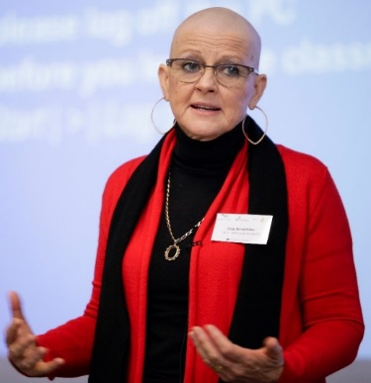
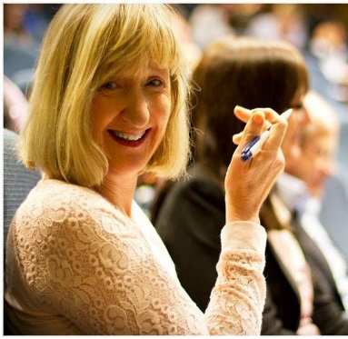


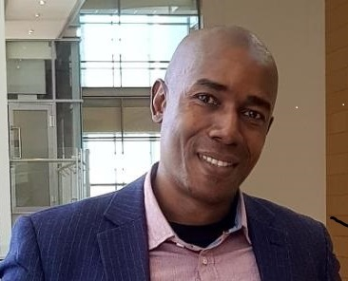

SARChI Chair: Minerals Beneficiation
Professor Dee Bradshaw
Adding value through minerals
Building a platform for sustainable development in Africa through minerals and metals
Role in project: materials engineering, process systems design and multi-criteria decision support
Notes:
1. Responsibility for this particular project
2. SARChI is hosted by MtM in the Department of Chemical Engineering, which is a collaborative, inter-disciplinary research grouping which is concernd with the broader sustainability challenges facing the minerals industry.
Currently Dee Bradshaw is the chair holder, and I have working with her for
Our role in terms of expertise is in the are of material engineering, process systems design and multi-criteria decision support.

Slide 4
Framework: Process Design and Technology Selection
Quantitative understanding of material and energy flows over a whole array of unit operations as a function of technology efficiencies
Generation of alternatives
Data
Analysis of alternatives
micro-economic
environmental
socio-technical
technical
Inform next hierarchy
Measures of process performance against objectives/targets
Information
Decision-making
Selection of preferred alternative(s)
Informed
decision-making
Notes:
In terms of our approach, we will be using the generic process systems design and technology selection framework. This can be broken down into three steps. Firstly generation of laternatives in the form of process flow diagrams and input-output data. Iterative process

Slide 5
Process Design Stages
Broad perspective
low level of information,
complexity and certainty
Concept
Data
25-40% data uncertainty
Feasibility Design
Preliminary Design
Narrow perspective
high level of information,
complexity and certainty
Final Design
Notes:
With increasing articulation of detail and complexity on moving form the conceptual through to the final design stage. Conceptual design stage broad perspective, relatively high uncertainity.

Slide 6
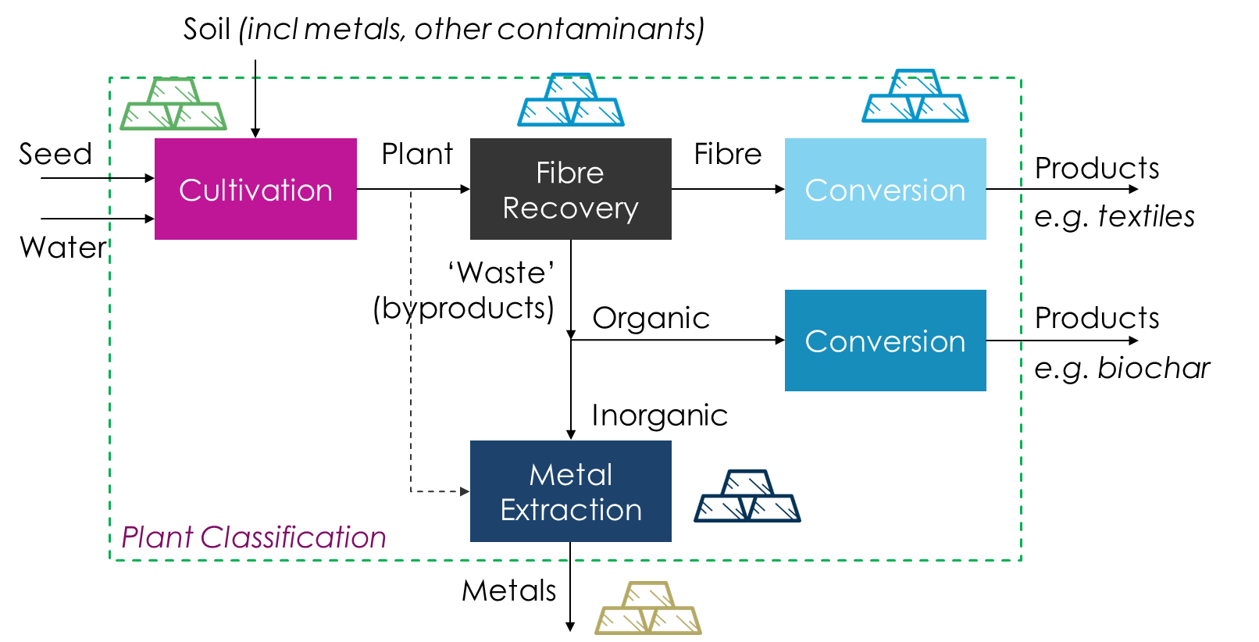
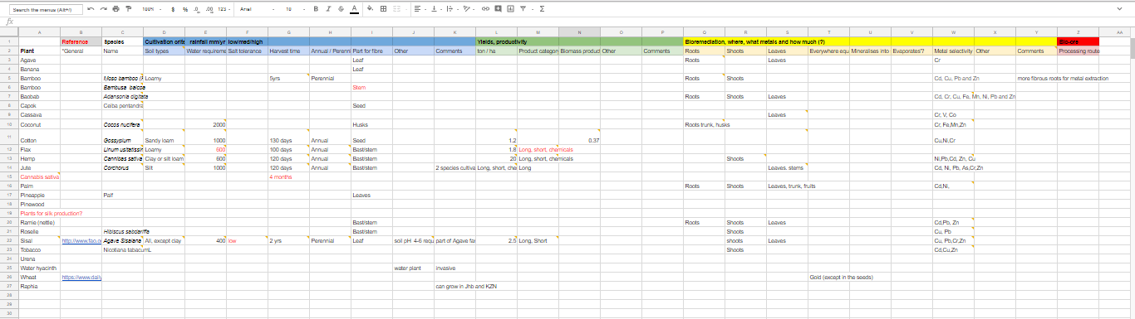
Step1: Generation of Alternatives
Block flow diagrams of options
  Literature
  Expert interviews
Inventory excel spreadsheets of input-output data
  Published literature
  Available in-house data and engineering heuristics
  Interviews
  Creative sleuthing – ornamental plants in mining town gardens?

Slide 7
Step 2: Evaluation of Alternatives
Stage 1: Initial simple semi-quantitative ranking and scoring
Resource and energy efficiency, consumption of materials, emissions and waste
Level of technological complexity and development
CAPEX and OPEX
Number of jobs and level of skills
Stage 2: More detailed feasibility studies on selected options
Life Cycle Assessment (Simapro modelling)
Techno-economic assessment

Slide 8
System Boundary: Upstream and Downstream Processes
Foreground system
Energy
Cultivation
Product
Material
Emissions
Water
Soil
Manufacturing
Waste
Processing
Background system
Studies to be conducted in collaboration with Centre for Bioprocess Engineering and Future Water Institute under the auspices of the SARChI for Bioprocess Engineering

Slide 9
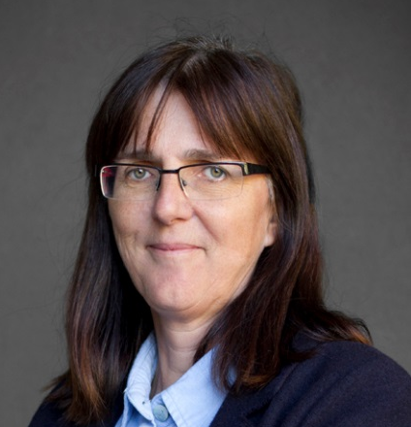



SARChI Chair: Bioprocess Engineering
Professor Sue Harrison
Bioprocesses for value from bio-resources
Building South Africa’s bio-economy through enhancing resource efficiency
Team:
Bernelle Verster
Shilpa Rumjeet
Xihluke Mabaso
Key research question:
Can fibre-rich plants serve the joint role of remediation of degraded mine land and fuelling of a multi-product value chain?
Notes:
1.

Slide 10
Cultivation of Fibrous Plants
Plant selection
Metal uptake
Water & Nutrients
Product-ivity
Soil quality
Soil science specialists
Fibrous plant specialists

Slide 11
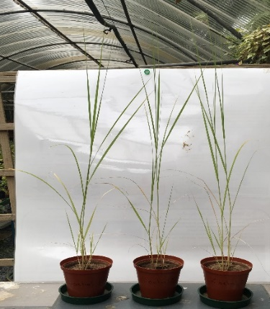
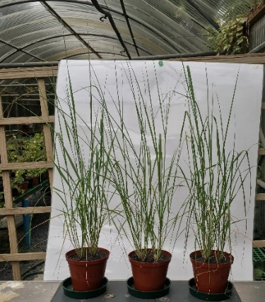
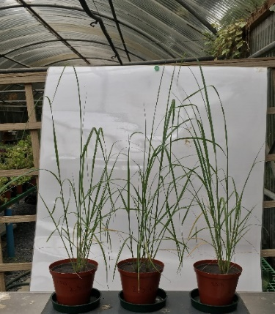
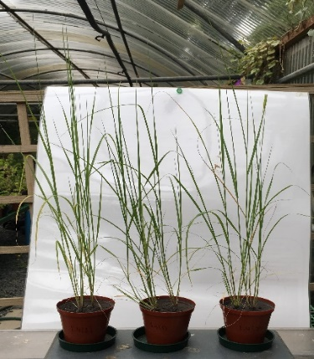
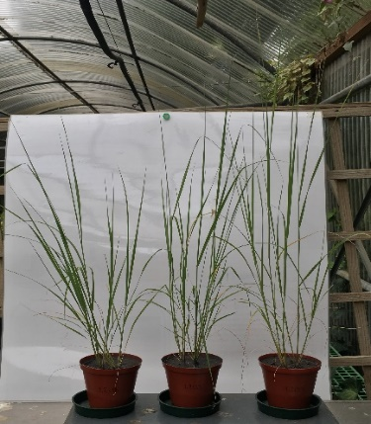
Upgrading the Land
Metal removal through phytoremediation
Enhanced soil structure
Re-vitalising the soil microbiome
Water retention
,,,
Control
CW/S 1:1 +A
CW/S 1:1+AS
CW/S 1:1+C+MR
CW/S 3:1+C+MR

Slide 12
Biorefineries
Biorefineries for Resource Efficiency
“biorefinery… integrates biomass conversion… to produce fuels, power, heat, and value-added chemicals.”*
Biochemical
Biomass
Combined power/heat
Fuels, chemicals, materials
Thermochemical
*http://www.nrel.gov/biomass/biorefinery.html

Slide 13
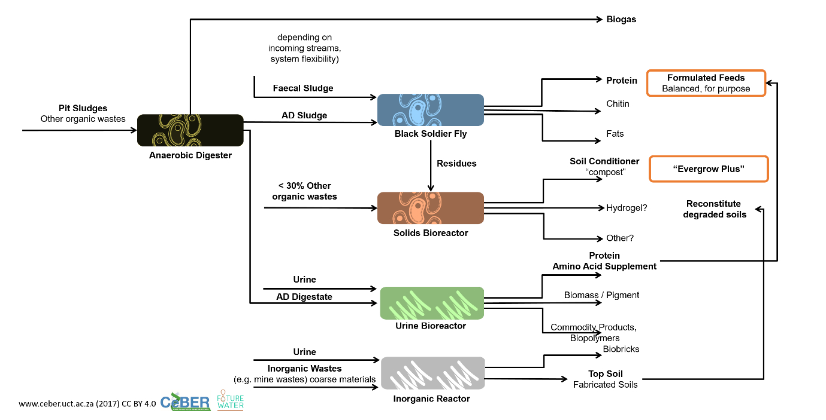
Biorefineries for Resource Efficiency
Feedstocks to the Fibrous Plant Biorefinery:
Leaves
Wood shavings
Metal –contaminated plant components
Spent wood pulp
Etc.
Towards products:
Lignocellulosic bioprocesses
Bioenergy
Biochemicals
A sanitation example:

Slide 14
Block Flow Diagram - Process Stages
Soil (incl metals, other contaminants)
Seed
Cultivation
Plant
Fibre Recovery
Fibre
Conversion
Products
e.g. textiles
Water
‘Waste’
(byproducts)
Organic
Conversion
Products
e.g. biochar
Inorganic
Metal Extraction
e.g. chemicals or bioenergy
Plant Classification
Metals
Notes:
Overarching “boundary” on plant classification determines process routes
Slide on each process and colour code each process, then can have slide on each box
Use a hypothetical example to illustrate how this concept will work

Slide 15
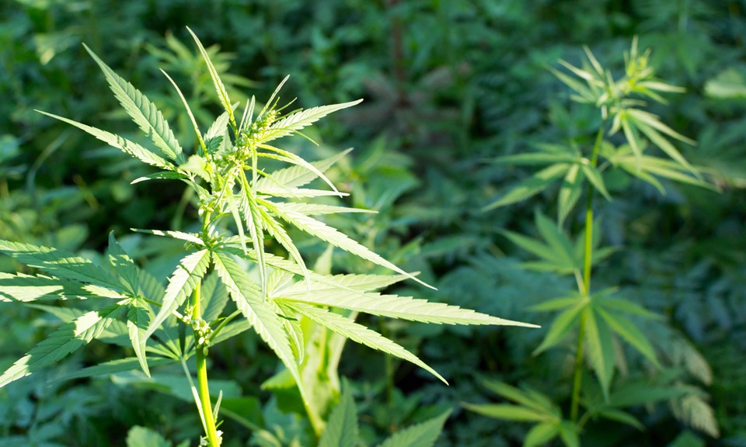
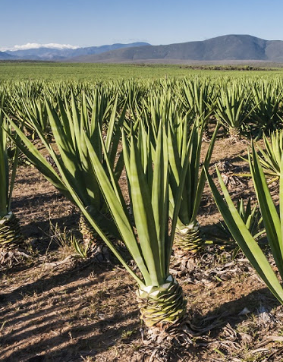
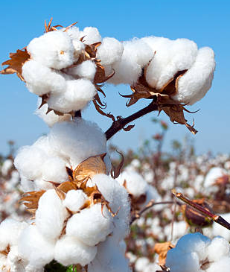
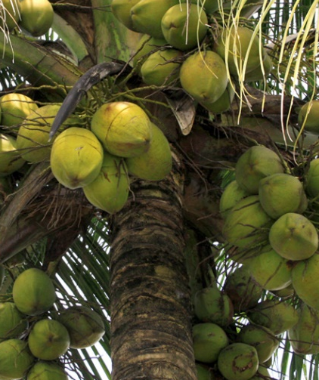
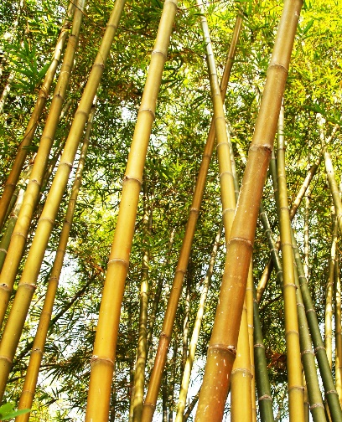
Fibre Plants Classification
Bast
Leaf
Seed
Fruit
Wood
Grass
Hemp
Sisal
Cotton
Coir
Bamboo
Notes:
Classification by which part of plant fibre is obtained.
Akil, H.M., Omar, M.F., Mazuki, A.A.M., Safiee, S., Ishak, Z.A.M. & Abu Bakar, A. 2011. Kenaf fiber reinforced composites: A review. Jawaid, M. & Abdul Khalil, H.P.S. 2011. Cellulosic/synthetic fibre reinforced polymer hybrid composites: A review. Lilholt, H. & Lawther, R., 2002. Natural organic fibres. In: A. Kelly & C. H. Zweben, eds. Comprehensive Composite Materials. New York: Elsevier Science, p. 5.

Slide 16
Input-Output data: Examples of criteria
Criteria | Details
Cultivation | Incl soil type, pH, water requirement
Tolerance to contamination | Salts, metals (details)
Rainfall | mm per year or growing season
Growth time | Annual or perennial, time to harvest
Yields, productivity | Ton/ha, fraction to product, etc
Part of plant used for fibre | Root, Shoot, Leaf, Seed, Husks, Stem, Bark, Soil, Whole plant
Bioaccumulation | Which metals, how much and where in the plant?
Metal recovery Processing route | Incinerate, other options?
What other contamination to consider?
How does this compare to where metals bioaccumulate?
How does recovery options compare to conventional metallurgy processes?

Slide 17
Expected outcome
Easy reference table comparing crops in terms of cultivation, yields, bioremediation and bio-ore processing (biomining)

Slide 18

The perfect plant
Characteristic | Why is this perfect?
Perennial | Keeps soil integrity, wider root network, saves on planting labour. Probably a tree?
Deciduous, Accumulates metals in the leaves (or some specific place) | Biomining: move through plantation shaking the leaves into a truck ☺
Decent yields of metals | Better than mining
Decent yields of fibre product. Fast growing wood ? | Good economic basis
Tolerant to everything Doesn’t need water Grows in every soil available | We’re not too picky
Non-invasive | Invasives have had many unintended consequences
Disclaimer:
This is not impossible, but it’s very unlikely.
Trade-offs will have to be made.

Slide 19

Hypothetical Plant
The perfect plant as example:
Fibre from the trunk / bast
All metals in leaves
Shoot system
Bast/Stem
Root system
Notes:
Picture of a hypothetical plant

Slide 20



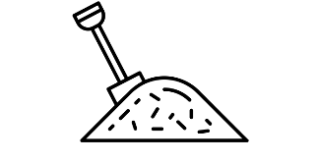
Fibre Recovery
Plant
Harvest
Stem
Fibre Separation
Fibre
byproducts
byproducts
Fibre recovery involves two stages - harvest + fibre separation
Fibre separation is usually a number of steps - mechanical (e.g. decortication) or chemical processes

Slide 21
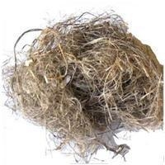
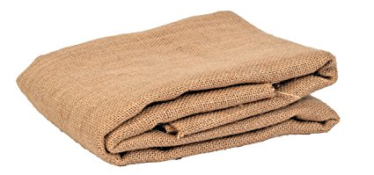
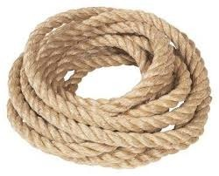
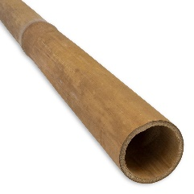
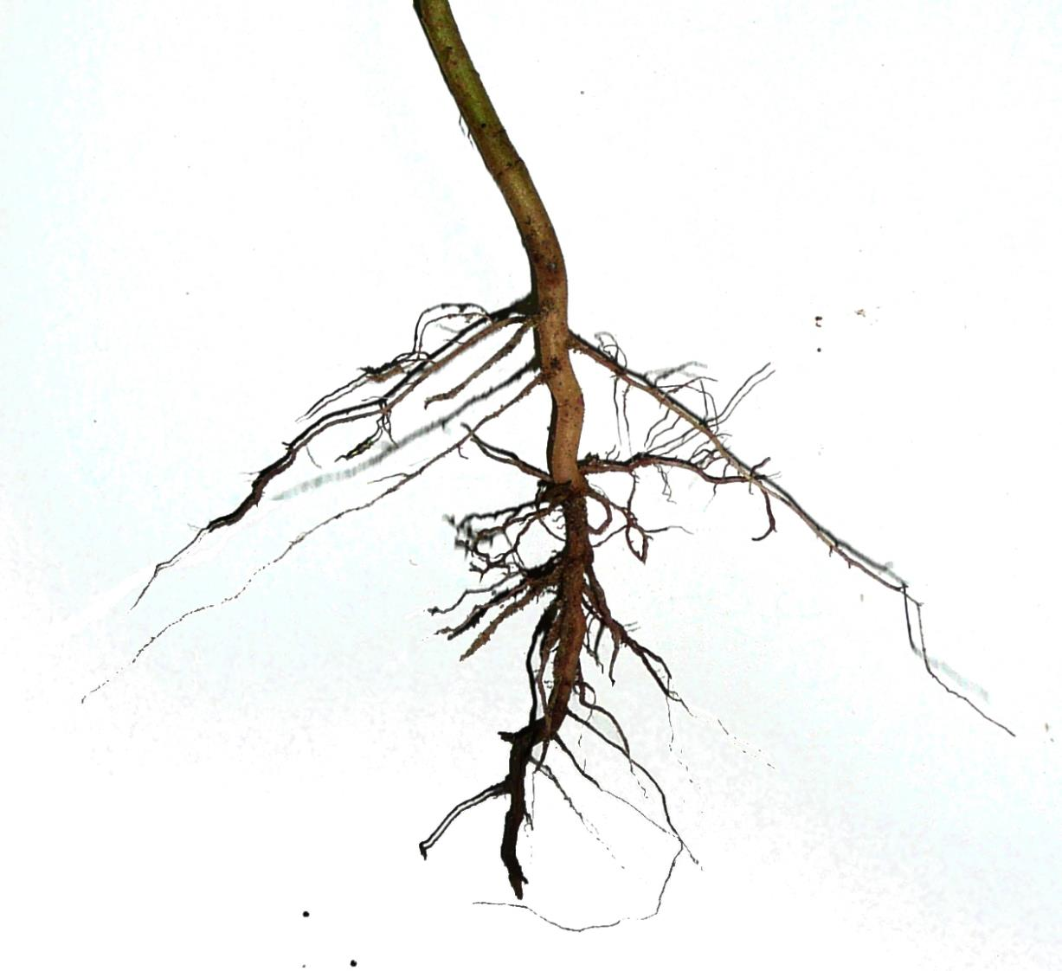
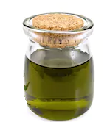

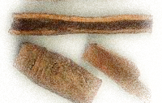
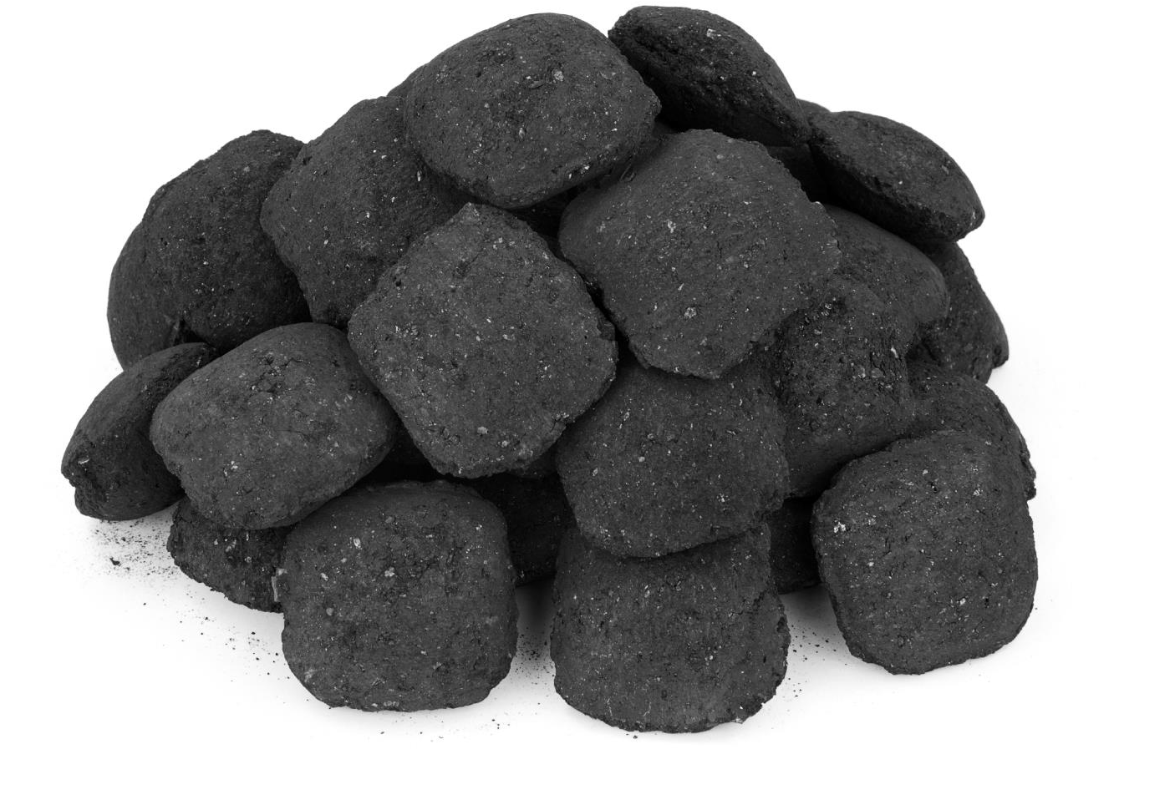
Conversion into Products
Product Categories
End-products (examples)
Fibre
Long Fibre
Short Fibre
‘Waste’ byproducts
Woody tissue
Chemicals
Energy
Five broad product categories from production process
Similar class crops have similar production steps
Notes:
Chen, J. Y., & Liu, F. (2010). Bast fibres: From plants to products. In B. P. Singh (Ed.), Industrial crops and uses (p. 318). CAB International.

Slide 22


Metal and Fibre Recovery
Plant
Harvest
Stem
Fibre Separation
Fibre
byproducts
byproducts
Fibre recovery involves two stages - harvest + fibre separation
Fibre separation is usually a number of steps - mechanical (e.g. decortication) or chemical processes

Slide 23



Metal Extraction – Bio-remediation
Metal ions
Phytodegradation
Phytoextraction
Pollutants are degraded or mineralized by specific enzyme activity
Pollutants are accumulated in harvestable parts of plant
Phytostabilisation
Phytovolatisation
Pollutants are immobilized in the soil
Pollutants are released into volatile form through plant
Phyto = plants
Phyco = algae
Hyperaccumulators naturally absorb large amounts of metals
For example hemp shown to accumulate Ni, Cd, Pb in shoot
Notes:
Mechanisms of hyper-accumulators
https://www.annualreviews.org/doi/10.1146/annurev.arplant.56.032604.144214
Soil and plant factors influencing the accumulation of heavy metals by plants. https://www.ncbi.nlm.nih.gov/pmc/articles/PMC1637297/

Slide 24
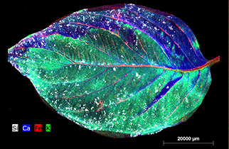
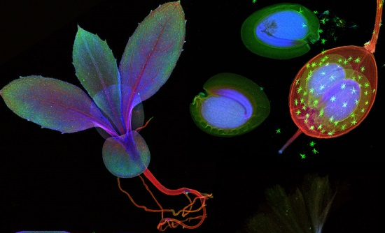
X-Ray images of metals accumulated in plants
Pictures From SMI- CMLR work in New Phytologist
https://www.newphytologist.org/news/view/193
Notes:
Pictures From SMI- CLR work in New Phytologist
https://www.newphytologist.org/news/view/193
https://www.newphytologist.org/blog/behind-the-cover-new-phytologist-2182-april-2018/

Slide 25
Metal and Fibre Recovery
Plant
Harvest
Metal Extraction
Metals
byproducts
byproducts
Plant material containing metals referred to as “bio-ore”
Dry-ashing and wet oxidation are the two widely adopted methods to extract metals from plant material

Slide 26
Key Questions
What has been done in the fibre economy space?
What is the main selection criteria for plant-based rehabilitation of land currently in SA?
What fibre based products have been/are made in SA?
What fibre recovery processes are commonly used?
Fibre processing in SA – what are the main waste products and what has been/is currently done with the waste?
Any projects known using fibre crops for bioremediation or metal uptake in SA or globally?
Any known barriers or challenges (environmental, social, economic) to the potential utilisation of fibre-based plants?
What re the most common barriers or challenges to plant-based rehabilitation of degraded lands?

