Slide 1
BAMBOO VALUE CHAIN OPPORTUNITIES WITHIN THE SOUTH AFRICAN MARKET
Dr Hamman Oosthuizen
Director: OABS
Lecturer Extraordinary: Stellenbosch University
28 May 2018

Slide 2
PRESENTATION LAYOUT
Background
Bamboo industry overview
SA production capacity
INBAR study tour - China
Bamboo industry conceptual framework
Cluster approach
Summary

Slide 3
BACKGROUND
Study was done in 2010/2011 for IDC
Study included an INBAR study tour to China

Slide 4
BAMBOO INDUSTRY OVERVIEW
Global export value = USD 2,503million (UN Comtrade, 2007)

Slide 5
BAMBOO INDUSTRY OVERVIEW
Bamboo and rattan furniture and seats (26%), bamboo industrial products (26%) and bamboo plaited products (12%) constitute the largest products of global exports.
Global exports of bamboo products reached USD 2,5-billion in 2007. It was projected to reach USD 5-billion in 2011 and between USD 15-billion and USD 20-billion in 2017 (INBAR, 2011).
China is by far the largest exporter with 46% market share followed by Indonesia (16%) and Vietnam (5%).

Slide 6
BAMBOO INDUSTRY OVERVIEW
The biggest importers are European Union (29%), USA (18%) and Japan (10%).
South African imports of bamboo and rattan products in 2007 were in excess of R120-million in 2007 and decline to R100-million in 2010 correlating with the global financial crisis trends.
Bamboo and rattan exports from South Africa followed the trend and declined from R30-million in 2007 to a mere R7-million in 2010.

Slide 7
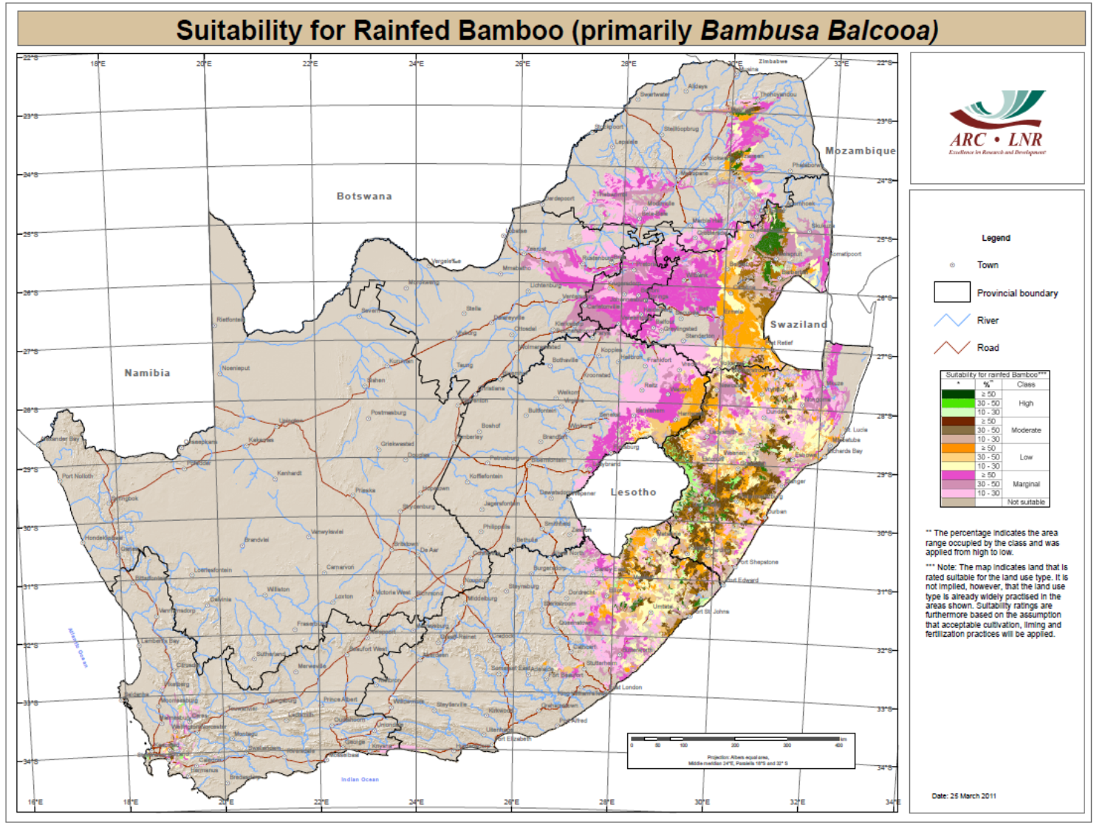
SA PRODUCTION CAPACITY

Slide 8
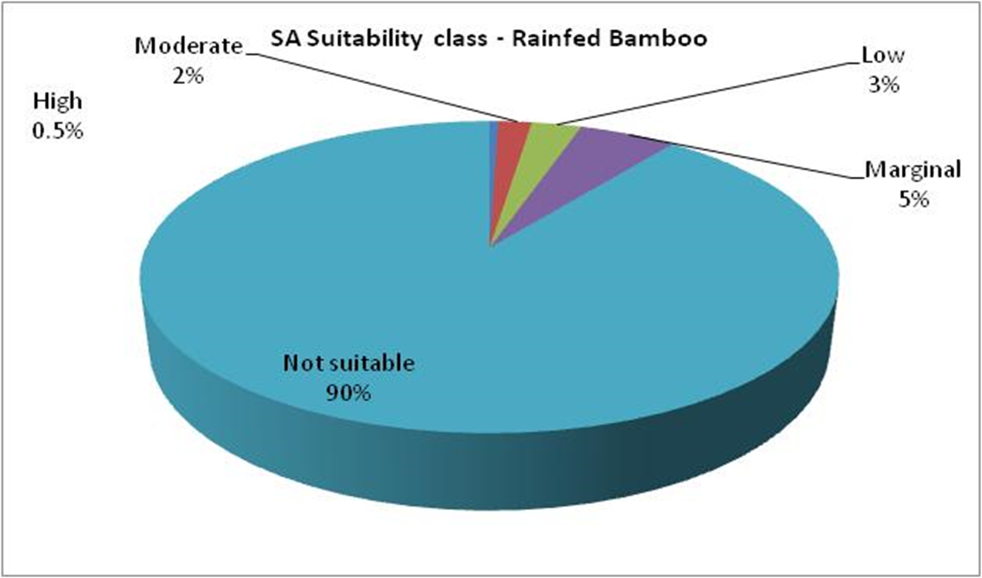
SA PRODUCTION CAPACITY
Only 0.5% of SA is suitable for production of rainfed Bamboo

Slide 9
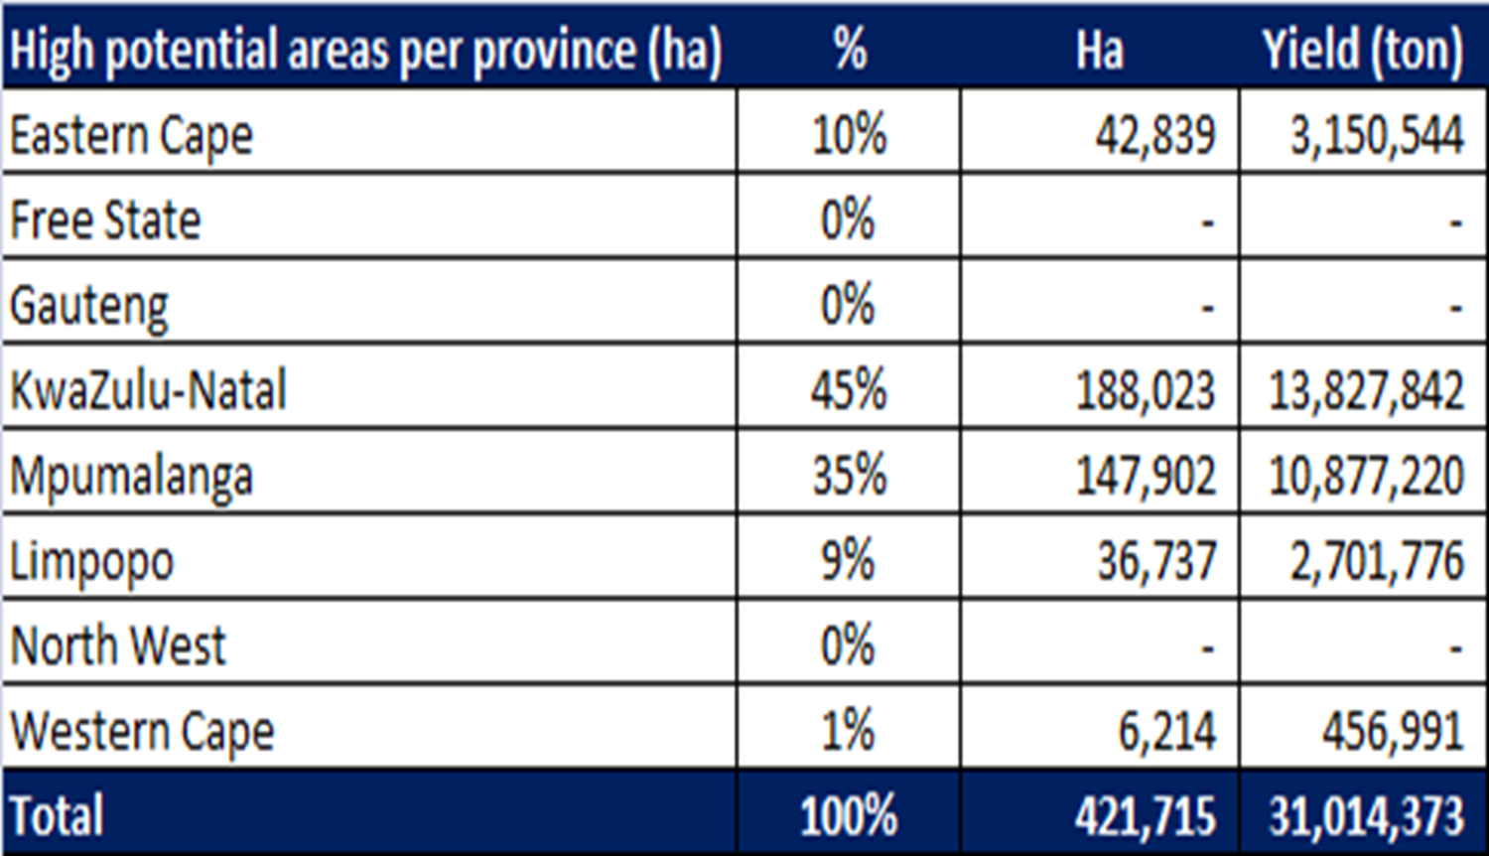
SA PRODUCTION CAPACITY
In total 421 715 ha is suitable for production of rainfed Bamboo

Slide 10
INBAR STUDY TOUR- CHINA
Production (Bambusa Balcoa)
  Row width = 6m x 6m
  Nr Clumps / ha = 277
  Max culms / clump (matured plant) = 25
  Max culms / ha = 6 945 (reasonable - not more)
  Average weight of culm = 30kg (may be higher for SA)

Slide 11
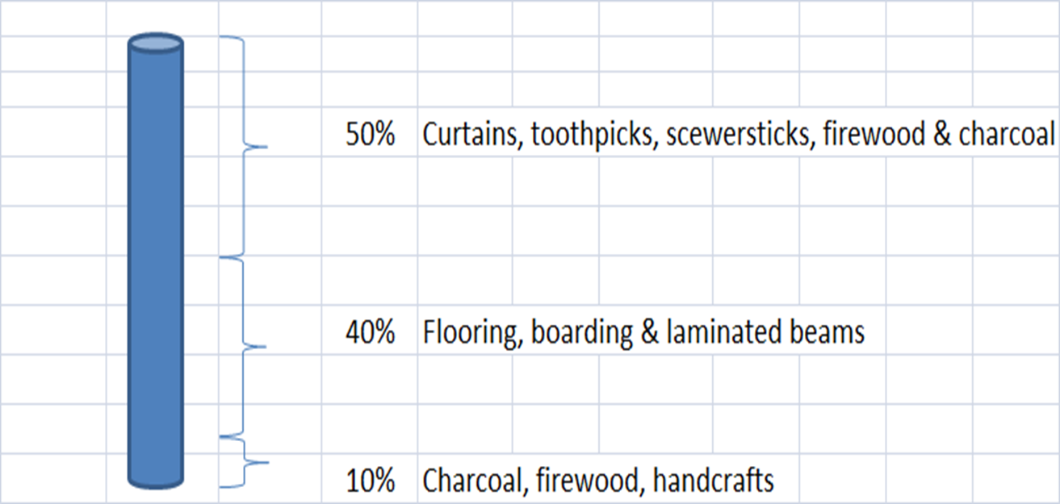
INBAR STUDY TOUR- CHINA
Culm division & application

Slide 12
INBAR STUDY TOUR- CHINA
Culm division (most likely):
  8kg flooring, boarding & laminated beams (26%).
  2kg charcoal, firewood & handcrafts (6,7%).
  5kg curtains, toothpicks, skewersticks, firewood, charcoal (16,7%).
  12kg waste use (pelletize for energy) (40%)

Slide 13
INBAR STUDY TOUR- CHINA
Boarding, flooring & panels:
  For flooring, boarding and panels it is important to take into account that from planting it will take at least four years for the plant (clump) to generate the correct size (80-100mm) culms.
  Thereafter these culms should stay in the plantation for another four years to develop to such an extent that it will be suitable for timber manufacturing.

Slide 14
INBAR STUDY TOUR- CHINA
Boarding, flooring & panels:
  It will thus take 8 years after establishment of a plantation before the plantation will deliver its first bamboo suitable for timber production.
  Processing of bamboo into boarding, flooring and panels seems to be a relative straight-forward process with the correct machinery, management skills and skilled labor-force.

Slide 15
INBAR STUDY TOUR- CHINA
Bamboo weaving:
  Bamboo weaving seems to be the appropriate starting point for South Africa to enter into the bamboo industry.
  Raw material (bamboo strings for weaving) can be imported from China and on-site training could be provided by a Chinese company.
  Duration of training is 6 weeks for weaving and 3 weeks for furniture manufacturing.

Slide 16
INBAR STUDY TOUR- CHINA
Bamboo crafts:
  Bamboo crafts alongside Bamboo weaving - entry points into the bamboo industry.
  For both these sub-industries the raw material will be readily available from imports and which can later be substituted by early-stage plantation production.

Slide 17
INBAR STUDY TOUR- CHINA
Bamboo charcoal:
  The production of bamboo charcoal has a long history in China which originated in ancient times.
  Although it is a simple process, care should be taken in the management of heating (ovens) and timing of the processes.
  Bamboo vinegar is a by-product from the charcoal process with application as bio-pesticide and is not suitable for human or animal consumption.

Slide 18
INBAR STUDY TOUR- CHINA
Bamboo charcoal:
  It seems that Moso specie is deemed as most appropriate for bamboo charcoal.
  Moso specie is however classified as a runner and will most likely not be allowed for commercial plantation in South Africa.
  It needs to be investigated whether bamboo charcoal will be competitive to existing charcoal products in South Africa and how it will be perceived by the market.

Slide 19
INBAR STUDY TOUR- CHINA
Bamboo charcoal:
  Chinese factories use bamboo waste in their plants to generate steam for drying of bamboo.
  The production waste make out a substantial part of original weight and needs to be applied in some way.
  For the interim until boarding factories are up and running, it can be pelletized for energy.

Slide 20
INBAR STUDY TOUR- CHINA
Bamboo shoots:
  Bamboo shoots as edible dish is very popular in China.
  Hygiene control is very important and strict measures are in place.
  Vacuum-packed processed shoots can last for 12 months if correctly treated.
  China’s harvesting season is different from SA’s and therefore there may proof to be a market in China over December peak for fresh shoots from SA.

Slide 21
INBAR STUDY TOUR- CHINA
Bamboo shoots:
  Opportunity for counter-seasonal trade with the northern hemisphere.
  Bamboo shoots have good nutritional contents and are quite suitable for animal fodder.
  Chinese family consumes 1kg per day.
  Japanese imports = 5kg/capita/annum

Slide 22
INBAR STUDY TOUR- CHINA
Bamboo poles:
  The process where sugar, starch and cellulose is removed from bamboo culms makes bamboo appropriate to use as poles which is pest resistant.
  The lifespan of bamboo poles is however short (5-10 years) and bamboo poles thus seems not to be ideal to serve as support structure for vineyards, etc., which has a longer lifespan.
  It may however be suitable for e.g. tomato production or any other applications which does not require a very long lifespan.

Slide 23
INBAR STUDY TOUR- CHINA
Bamboo research:
  From our visit to two universities in China, it is obvious that the Chinese regard research and development as an integral part of their bamboo industry.
  Most of the bamboo products is also to be seen at the universities and can be assumed that primary research was done by universities in collaboration with production companies.
  Identified Universities are keen to collaborate with SA counterparts.

Slide 24
INBAR STUDY TOUR- CHINA
Lessons learned:
  The Bamboo industry in China is a huge industry which exists for centuries.
  Various applications for bamboo originated in ancient times and are still in use today.
  Basically all parts of the plant can be put to use if the industry chain is well-managed.
  Economy of scale will however impact on different applications and therefore needs careful consideration in order to compete successfully in a free-market economy and ensure sustainability of the envisaged bamboo industry in SA.

Slide 25
INBAR STUDY TOUR- CHINA
Lessons learned:
  South Africa is in a favorable position to initiate a bamboo-industry. Further research should be done to ensure that the correct species are planted at the best suitable locations. The choice of best suitable species to be planted will be dictated by amongst others:
    physical-biological factors, market demand, market location, workforce level of skills, competitive advantages, socio-economic considerations, etc.

Slide 26
INBAR STUDY TOUR- CHINA
Lessons learned:
  It will be crucial and in everyone’s best interest to do proper research and planning before rushing in and in the process make costly mistakes. Not only will this harm the industry’s image but also damages communities trust.
  The bamboo industry seems to offer the necessary elements to provide job creation and poverty alleviation on a large scale while also contributing to a more sustainable and greener environment.
  Proper research, planning and implementation however will eventually determine the ratio of success.

Slide 27
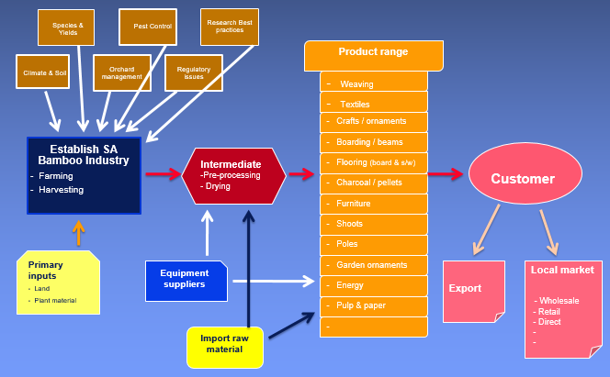
BAMBOO INDUSTRY CONCEPTUAL FRAMEWORK

Slide 28
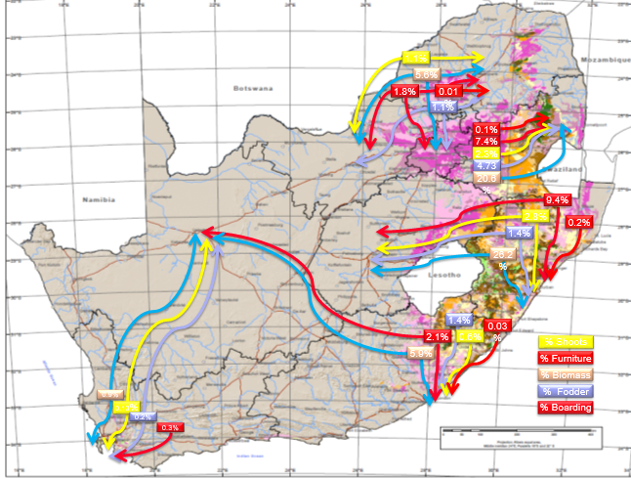
BAMBOO POTENTIAL PRODUCT FLOW

Slide 29
CLUSTER APPROACH
Six different product groups were identified to make up a cluster and utilize all parts of the bamboo plant, produced by the bamboo farming operation, namely:
  Bamboo Hand Weaving, 17 jobs;
  Bamboo Advanced Weaving, 17 jobs;
  Bamboo Furniture, 35 jobs;
  Bamboo Crafts, 37 jobs;
  Bamboo Manufactures Flooring and Boarding, 45 jobs;
  Bamboo Biomass for charcoal production, 8 jobs.
  170ha (17 612 t) – 159 jobs in processing plant

Slide 30
CLUSTER APPROACH
Farming – 170ha – 17 612 t
  17 on-farm permanent jobs
  262 seasonal jobs (3 months), i.e. FTE = 65 jobs
  Total FTE farming = 82 jobs

Slide 31
SUMMARY
The scoping study indicates that the establishment of a bamboo industry in South Africa seems to be viable and will make a notable contribution towards GDP contribution, job creation and poverty alleviation.
The scoping study was based on certain assumptions which influenced outcomes. These assumptions need further refinements to ensure accuracy.
International literature shows that research, product innovation, information, technology transfer, and marketing and promotion are paramount to the commercialization of the industry.

Slide 32

Thanks

Slide 33
THE END
Thank you !

Slide 34
BAMBOO PHOTO GALLERY

