Slide 1
BAMBOO VALUE CHAIN OPPORTUNITIES WITHIN THE SOUTH AFRICAN MARKET (PHOTO GALLERY)
Dr Hamman Oosthuizen
Director: OABS
Lecturer Extraordinary: Stellenbosch University
28 May 2018

Slide 2
The Ode to Bamboo
“A man can sit in a bamboo house under a bamboo roof, on a bamboo chair at a bamboo table, with a bamboo hat on his head and bamboo sandals on his feet. He can at the same time hold in one hand a bamboo bowl, in the other hand bamboo chopsticks and eat bamboo sprouts. When through with his meal, which has been cooked over a bamboo fire, the table may be washed with a bamboo cloth, and he can fan himself with a bamboo fan, take a siesta on a bamboo bed, lying on a bamboo mat with his head resting on a bamboo pillow. His child might be lying in a bamboo cradle, playing with a bamboo toy. On rising he would smoke a bamboo pipe and taking a bamboo pen, write on bamboo paper, or carry his articles in bamboo baskets suspended from a bamboo pole, with a bamboo umbrella over his head. He might then take a walk over a bamboo suspension bridge, drink water from a bamboo ladle, and scrape himself with a bamboo scraper.”
William Edgar Geil

Slide 3
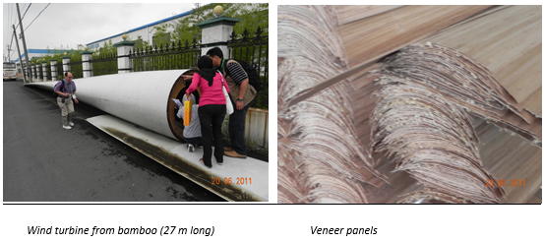
Bamboo Photo Gallery

Slide 4
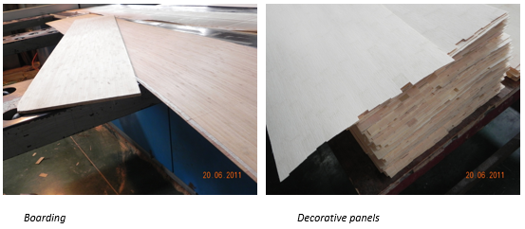
Bamboo Photo Gallery

Slide 5
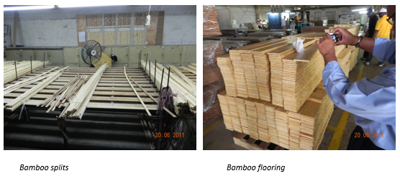
Bamboo Photo Gallery

Slide 6
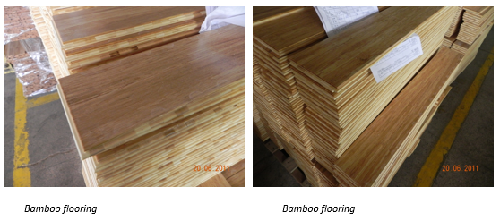
Bamboo Photo Gallery

Slide 7
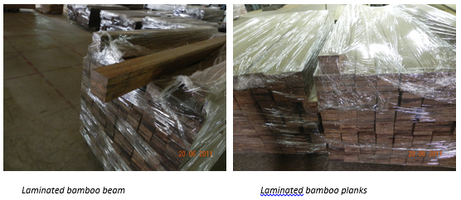
Bamboo Photo Gallery

Slide 8
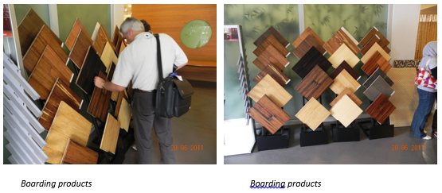
Bamboo Photo Gallery

Slide 9
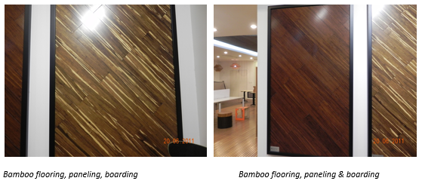
Bamboo Photo Gallery

Slide 10
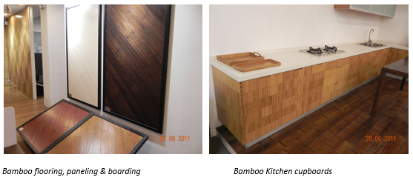
Bamboo Photo Gallery

Slide 11
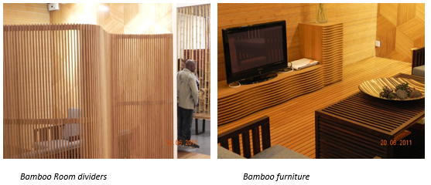
Bamboo Photo Gallery

Slide 12
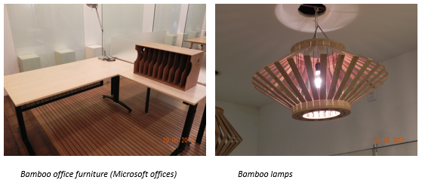
Bamboo Photo Gallery

Slide 13
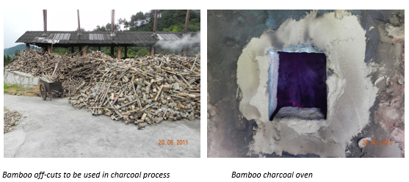
Bamboo Photo Gallery

Slide 14
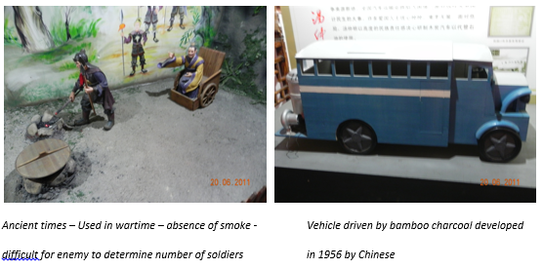
Bamboo Photo Gallery

Slide 15
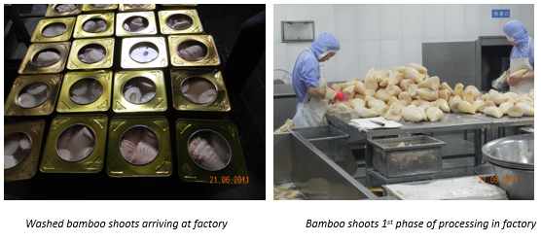
Bamboo Photo Gallery

Slide 16
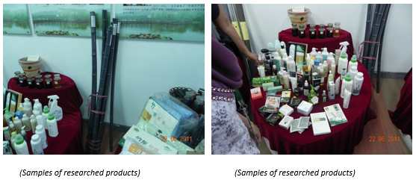
Bamboo Photo Gallery

Slide 17
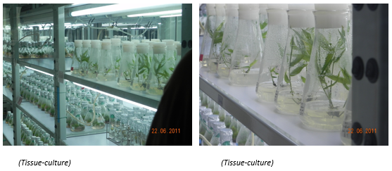
Bamboo Photo Gallery

Slide 18
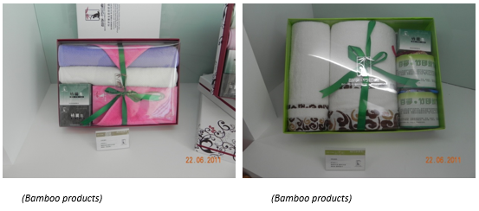
Bamboo Photo Gallery

Slide 19
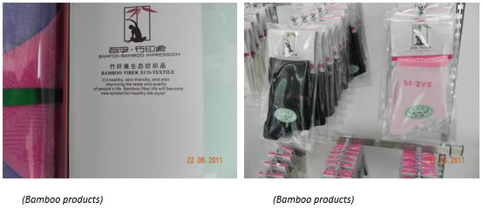
Bamboo Photo Gallery

Slide 20
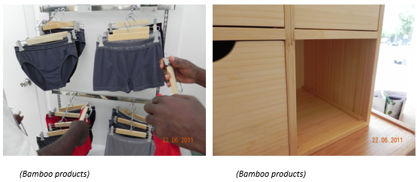
Bamboo Photo Gallery

Slide 21
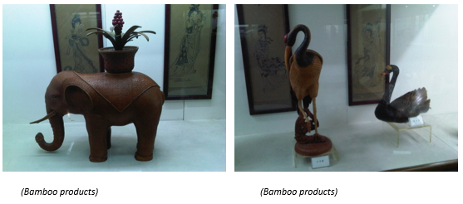
Bamboo Photo Gallery

Slide 22
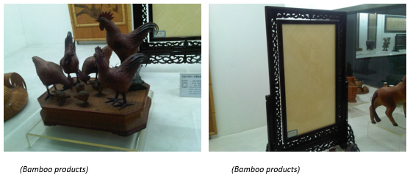
Bamboo Photo Gallery

Slide 23
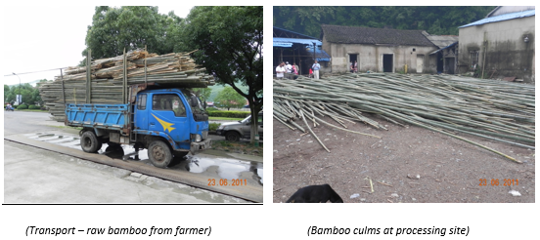
Bamboo Photo Gallery

Slide 24
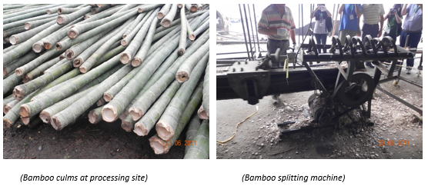
Bamboo Photo Gallery

Slide 25
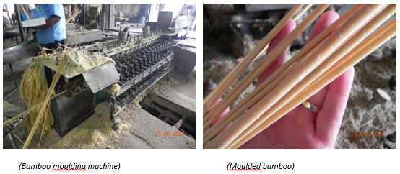
Bamboo Photo Gallery

Slide 26
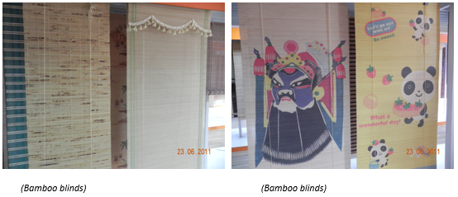
Bamboo Photo Gallery

Slide 27
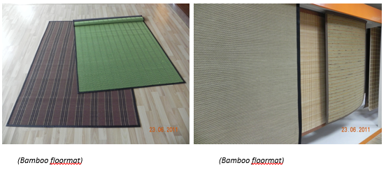
Bamboo Photo Gallery

Slide 28
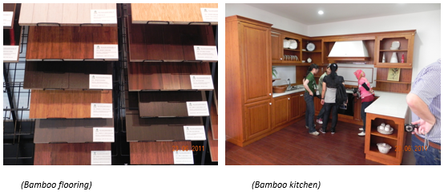
Bamboo Photo Gallery

Slide 29
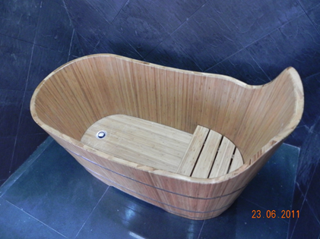
Bamboo Photo Gallery

Slide 30
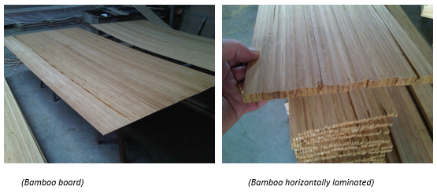
Bamboo Photo Gallery

Slide 31
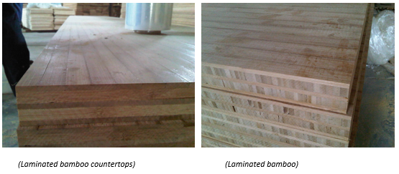
Bamboo Photo Gallery

Slide 32
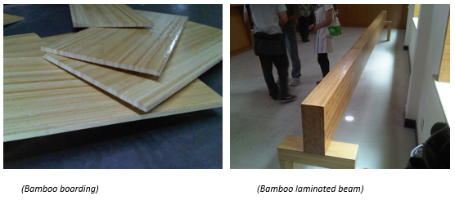
Bamboo Photo Gallery

Slide 33
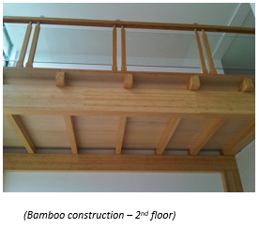
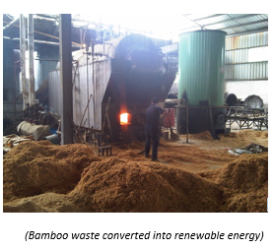
Bamboo Photo Gallery

Slide 34
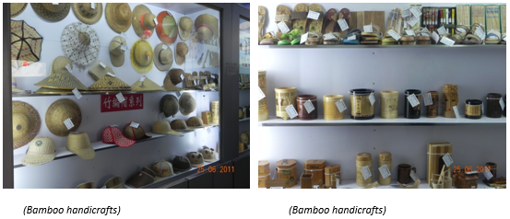
Bamboo Photo Gallery

Slide 35
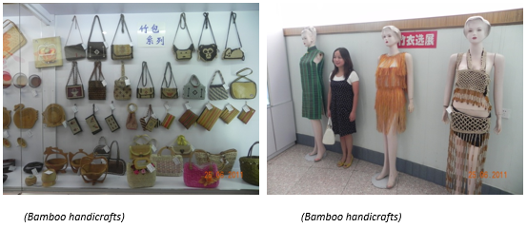
Bamboo Photo Gallery

Slide 36
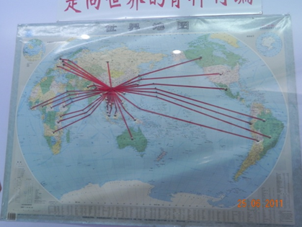
Bamboo Photo Gallery

Slide 37
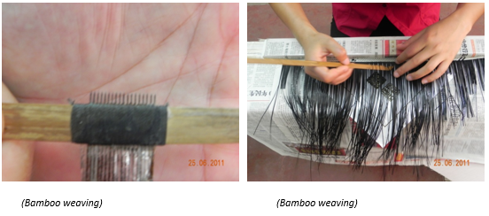
Bamboo Photo Gallery

Slide 38
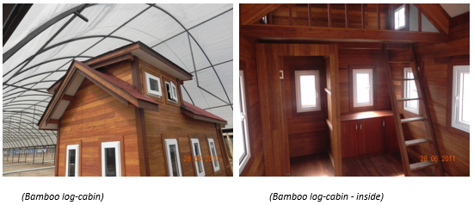
Bamboo Photo Gallery

Slide 39
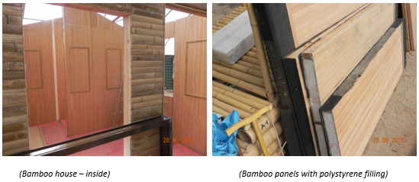
Bamboo Photo Gallery

Slide 40

Thanks

Slide 41
THE END
Thank you !

