Slide 1
Mining at the crossroads: Sectoral diversification to ensure sustainability? (work in progress)
Contents
Project duration: April 2016 – March 2019
Total budget R5.8m
Presented by Willem de Lange
28 May 2018

Slide 2
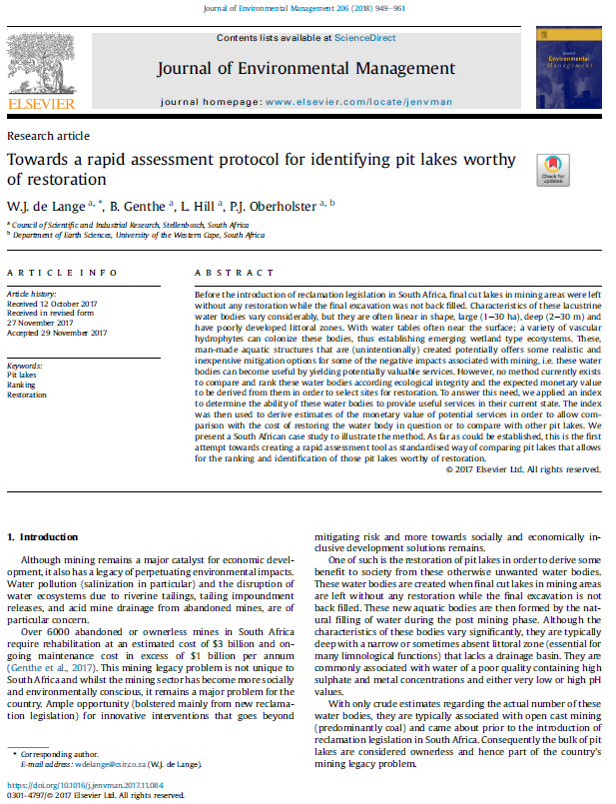
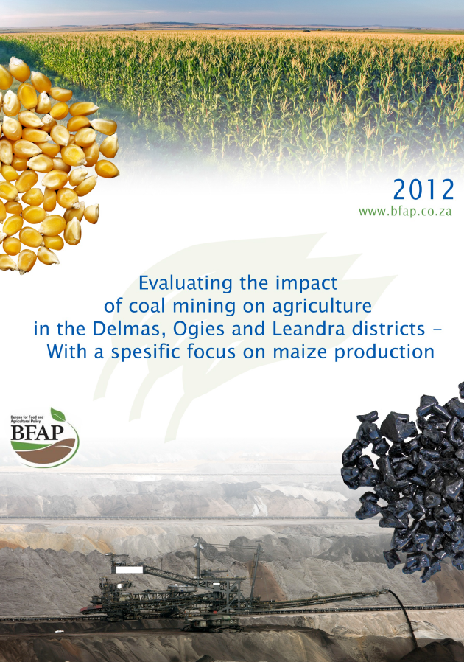
Context
Prior to this project: agricultural economics / environmental and resource economics with agricultural network (not mining)
2015 our RG became involved in pit lake evaluation:
Led to development of
this project (2016)
BEFAP report played
NB role
Notes:
Bureau for Food and Agricultural Policy

Slide 3
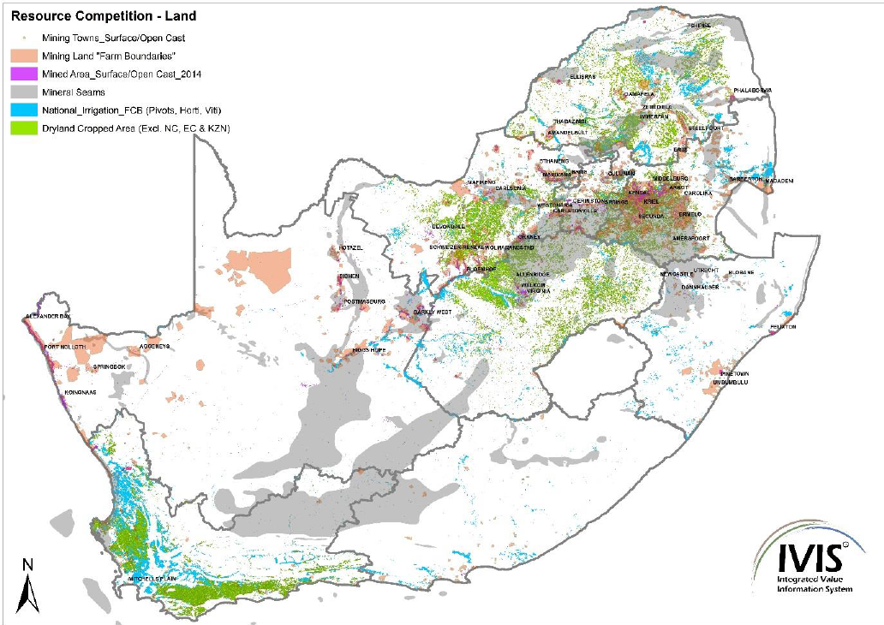
Context (cont.)
SA = 122.3 m ha
Farmland = 15.8 m ha (12%)
Contain minerals = 22.5 m ha (18%)
i.e. significant overlap
Source: BFAP, 2012

Slide 4
Context (cont.)
Both sectors are NB economic catalysts
But compete for and impact the same resource base (natural, manufactured, human and social)
Increased scarcity of resources points towards the need for improved collaboration instead of increased competition
But is this possible?
Our initial idea was to test this idea with the focus on the natural resource base (i.e. natural capital) and by means of a case study.
Original aims:
    assess the impact of mining on agricultural production by means of a modified production factor analysis focusing on input-output ratio comparisons and factor substitutability ratios (i.e. agric. production trials with AMD cocktails…)
    and then recommend changes to current legislation / mine closure protocol

Slide 5
Context (cont.)
  The worked aimed to explore the specification, requirements and extent to which mining liabilities could be turned into agricultural assets and be used as a way to improve relationships between mining and agriculture to hopefully engage/solve South Africa’s mining legacy problem.
However, after engaging with CSMI we realised that far more fundamental change is required… - also a prominent “cultural barrier” surfaced.
An opinion piece is current under review at Extractive Industries and society :
Mining at the crossroads: Sectoral diversification to safeguard sustainable mining?
Willem de Lange¹*, Benita de Wet¹, Lorren Haywood¹, William Stafford¹, Constansia Musvoto¹ and Ingrid Watson²
¹ Council for Scientific and Industrial Research, South Africa
² Centre for sustainability in mining and industry, University of the Witwatersrand, South Africa
corresponding author
Abstract
Green economic principles are paving the need for broadening the scope of planning and mining operations to incorporate diversification to other sectors as a formal part of the life cycle of mines. In this opinion piece we argue that sectoral integration of mining with other sectors holds the key to secure the long term sustainability of this sector. We explain this notion for the case for diversification to agriculture. It is hoped that this contribution ignites more debate on finding new ways to develop the complex relationships between sectors into mutual beneficial and cooperative coexistence based on true sectoral integration to improve the long term sustainability of economies.
Keywords
Sustainability, mining, integration, diversification, agriculture
Notes:
Centre for Sustainability in Mining and Industry

Slide 6
Current learning
We hypothesised at the beginning of this project that the legacy mining problem can be more effectively addressed if mining and agriculture migrate from a competitive to a synergistic relationship (i.e. improved collaboration)
We also realised that synergies are to be found at the interdependencies between mining and agriculture (i.e. the nexus)
However, HOW to realise this synergistic relationship remained unclear.
It seems that sectoral diversification of mining to other sectors (processing, manufacturing, conservation, tourism, services) could play an important role to secure the long term sustainability of this sector.
It is clear that green economic principles are paving the need for broadening the scope of mine planning and operations to incorporate diversification to other sectors as a formal part of the life cycle of mines.
However such diversification seems problematic for mines (“cultural resistance”).
Incentives for diversification thus becomes a major challenge.
We now consider sectoral integration within the same company as a means to diversify.
Currently we are looking at agriculture, i.e. how can/should mining approach the idea of diversification towards agriculture.

Slide 7
Current learning
We are not aware of commercial scale sectoral integration (as a diversification strategy) of mining and agriculture has not been done before in South Africa = novel?
The idea is riddled with challenges, but seems promising if successful (i.e. making the pollution pays principle profitable for the polluter without creating perverse incentives).
It is hoped that this contribution ignites more debate on finding new ways to develop the complex relationships between sectors into mutual beneficial and cooperative coexistence based on true sectoral integration to improve the long term sustainability of economies.
So the question should be asked whether or not it is possible to turn miners into farmers… my colleagues does not share my scepticism…

Slide 8
CSIR team
CSIR team:
 | Expertise | Contribution
Willem de Lange | Agricultural economics, environmental and resource economics | project leader, economic incentives
Paul Oberholster | Limnology | rehabilitation of polluted water bodies
Bettina Genthe | Water quality | pit lake rehabilitation
Constansia Musvoto | Agronomy | agricultural production
Douglas Trotter | Rehabilitation ecologist | EIA, SEA specialist
Lorren Haywood | EIA, SEA specialist | business risk
Benita de Wet | EIA, SEA specialist | EIA, SEA specialist input
William Stafford | Biochemistry | bioremediation
Ray Durrheim | Geophysics | mining rehabilitation
Navin Singh |  | CSIR mining division

Slide 9
Current network in terms of project
Currently limited in mining!
My network lies in agriculture – mining is a new field to me and this project focus this on networking, i.e. a focused effort to build our network and relations in this field.
 | Affiliations | Expertise
Ferdie Meyer | BFAP | Agricultural value chain analysis
Nick Vink | Department of Agricultural Economics, Stellenbosch University | Agricultural Economics
Wayne Truter | Department of Plant Production and Soil Science, University of Pretoria | Land Rehabilitation Specialist
Johann Beukes | Coaltech | co-network
Stephanie van der Walt | National Agricultural Marketing Council / Maize Trust
Johan van Rooyen | South African Agribusiness Chamber | Agricultural Economics
Dirk Troskie | Director: Business Planning and Strategy, Department of Agriculture | Agricultural Economics
Ingrid Watson | CSMI | co-network
Michael Soloman | Independent Mining & Metals Professional

Slide 10
Discussion

Slide 11
Current CSIR work on the treatment of AMD
Contents
Enquiries: Paul Oberholster
poberholster@csir.co.za

Slide 12
Context
CSIR has done quite a lot on passive treatment technologies (i.e. artificial wetlands with indigenous reeds and macrophites and filamentous green algae) to treat AMD

Slide 13
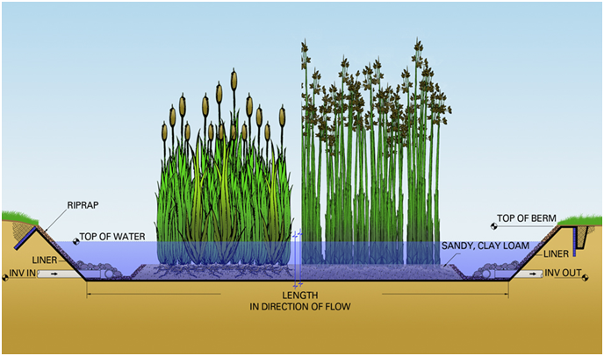
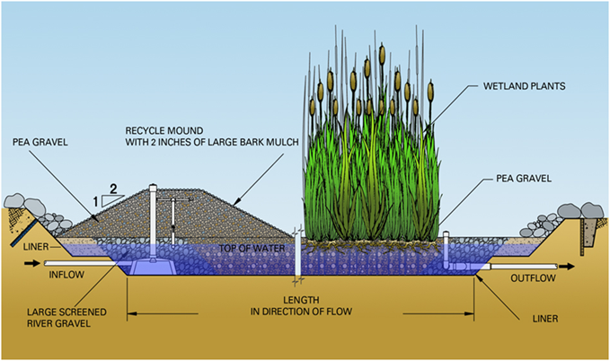


Context
Different Passive Treatment Systems
Surface flow wetlands (aerobic)
Subsurface flow wetlands (anaerobic)

Slide 14
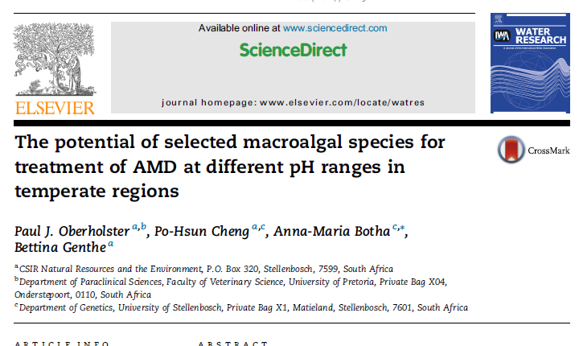
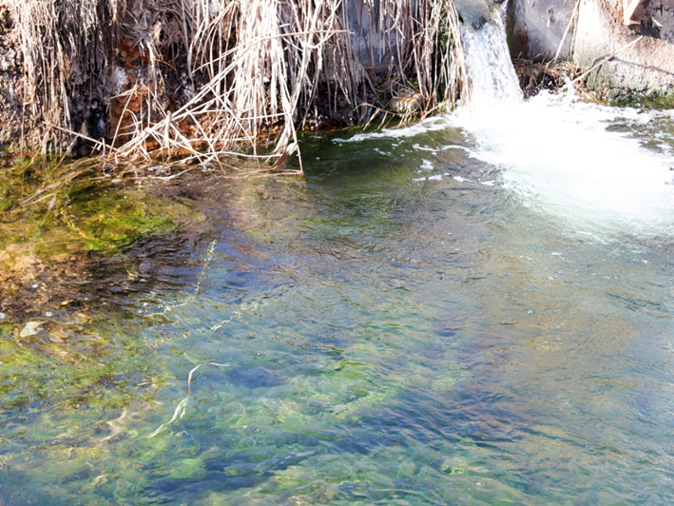
Screening
CSIR screened different algae species to treat AMD

Slide 15
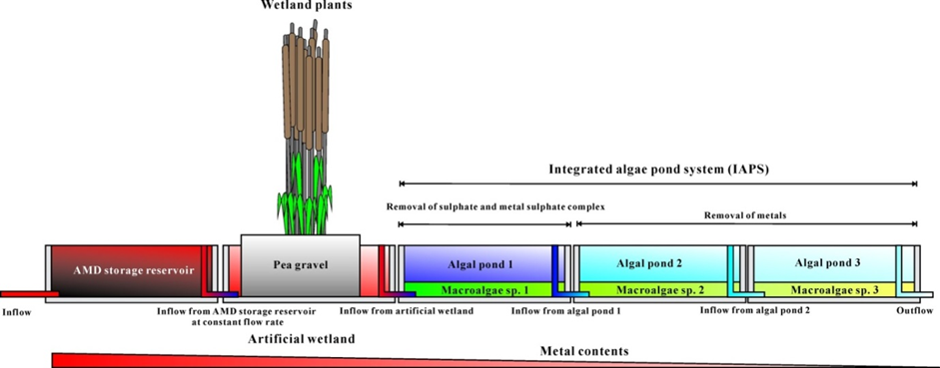
Hybrid system
Used the learning to design surface flow pilot hybrid system to treat AMD – reducing toxic metals and sulphate which is low cost infrastructure and low skilled labour requirements

Slide 16
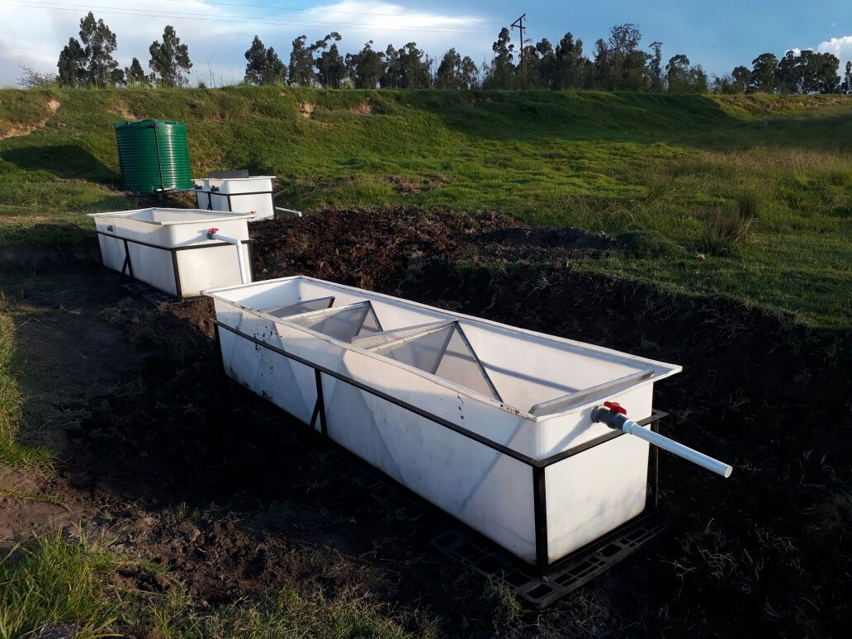
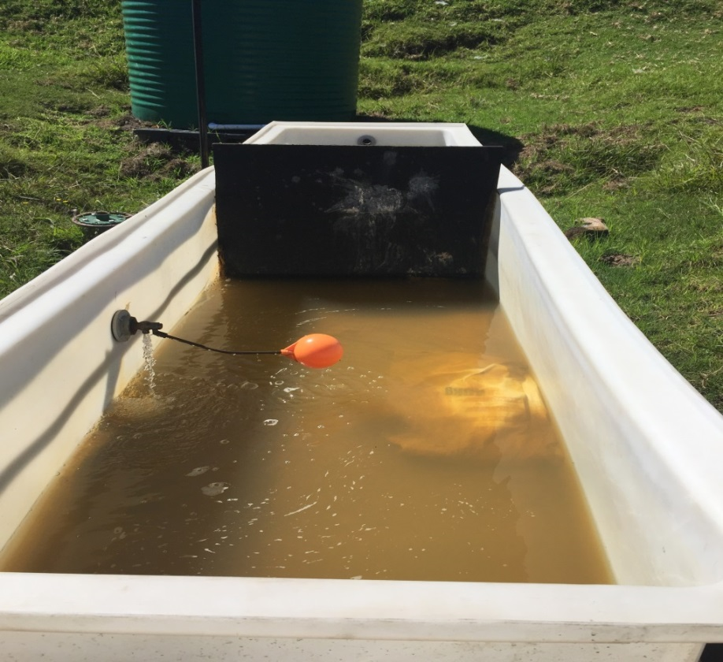
Pilot hybrid system
System treat 30 L/ hour using no electricity
Presentation
Notes:
carolina

Slide 17
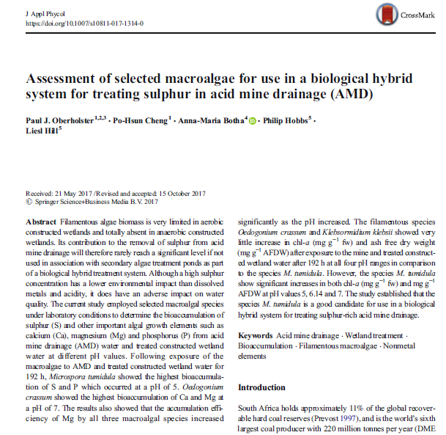
Publication on hybrid system
Presentation

Slide 18
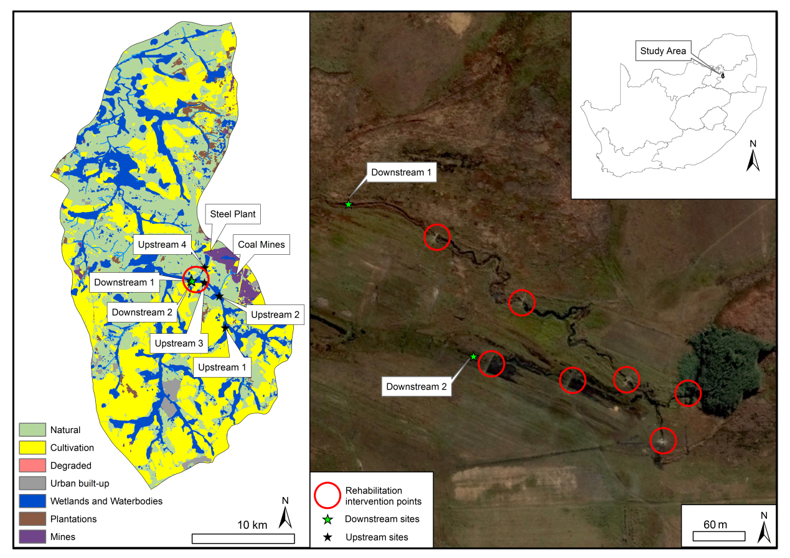

Up-scaling of hybrid system: Zaalklap Wetland Case Study
134 ha wetland at Zaalklap:
Collaborators:
Presentation

Slide 19
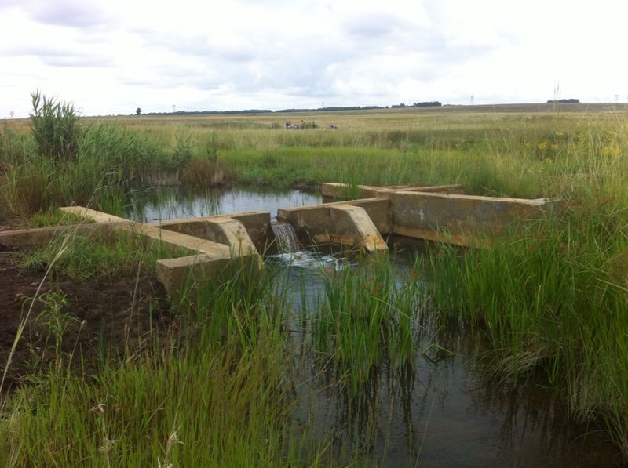
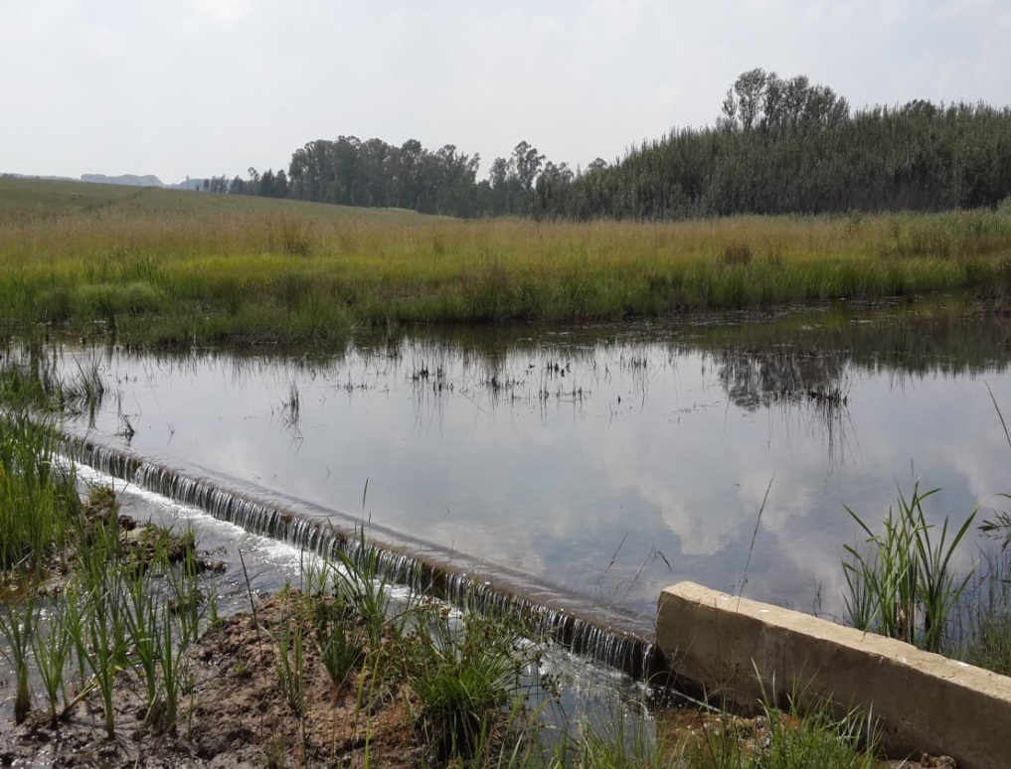
Zaalklap key result
Inflow pH 2.9 - outflow pH 7.1

Slide 20
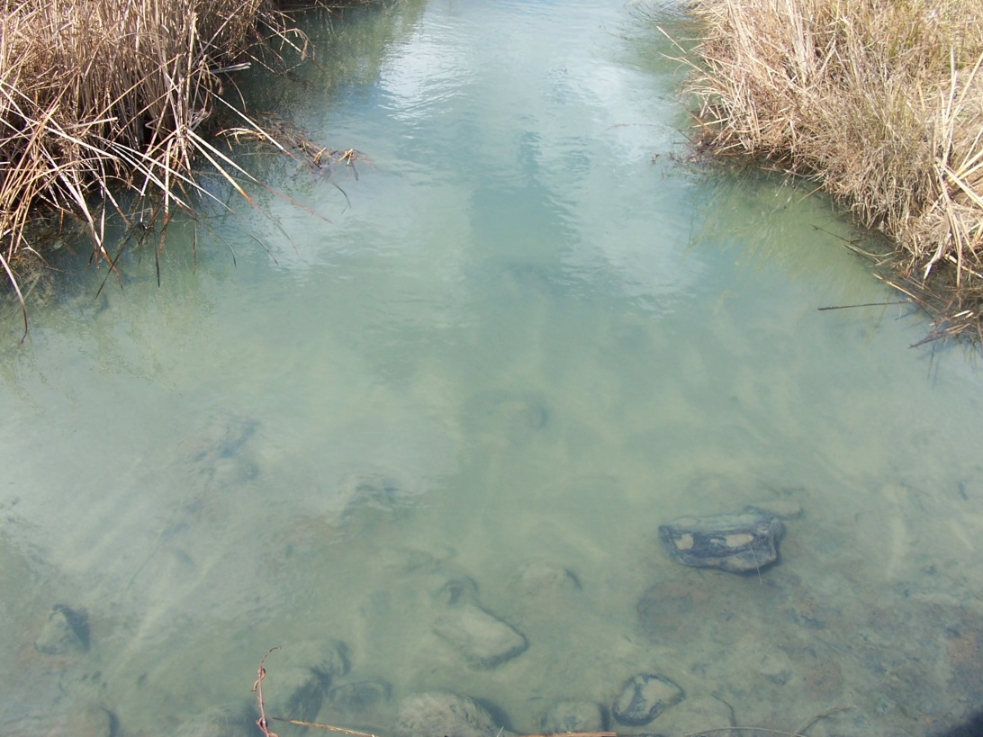
Impacts
Value of the water purification and waste assimilation service of the rehabilitated wetland was estimated between $1 700 – $7300/ha/year or $220 000 - $970 000 per year for whole wetland
Rehabilitation cost of wetland = $145 000 (once off)
These estimates are based on monitoring data of the CSIR taken within less than a season after rehabilitation – it is therefore expected that the value will increase as the wetland stabilises and matures.

Slide 21
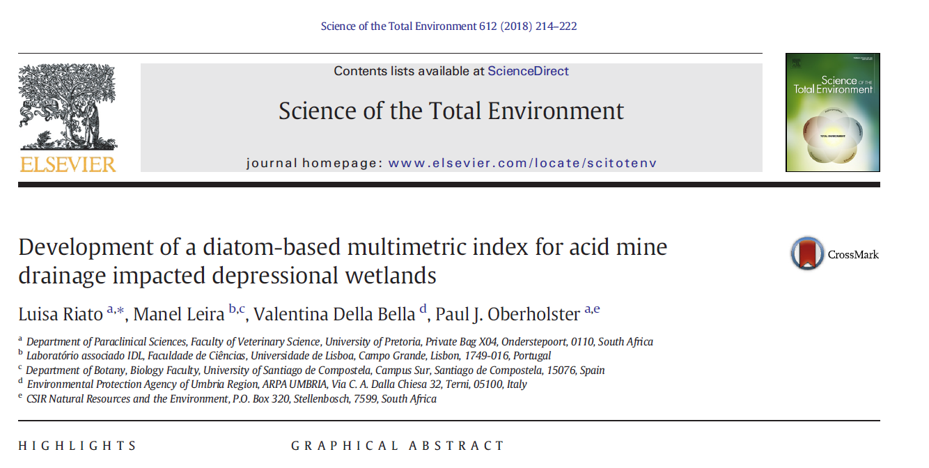
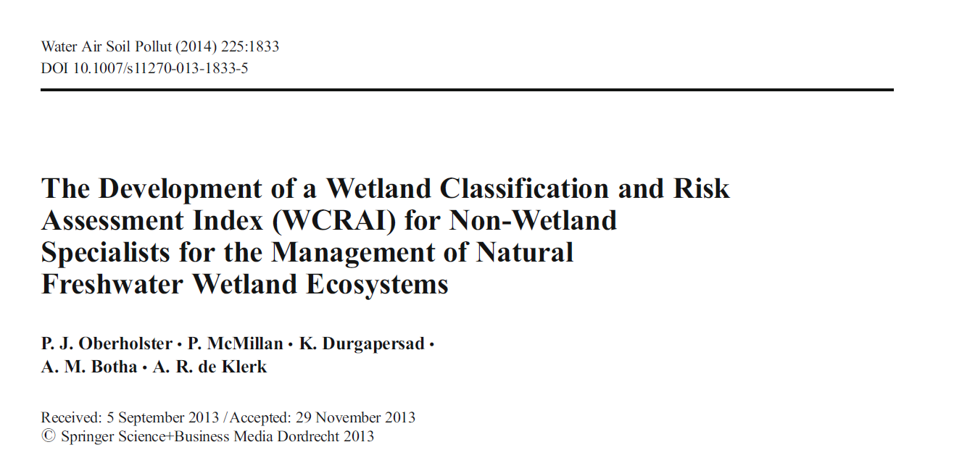
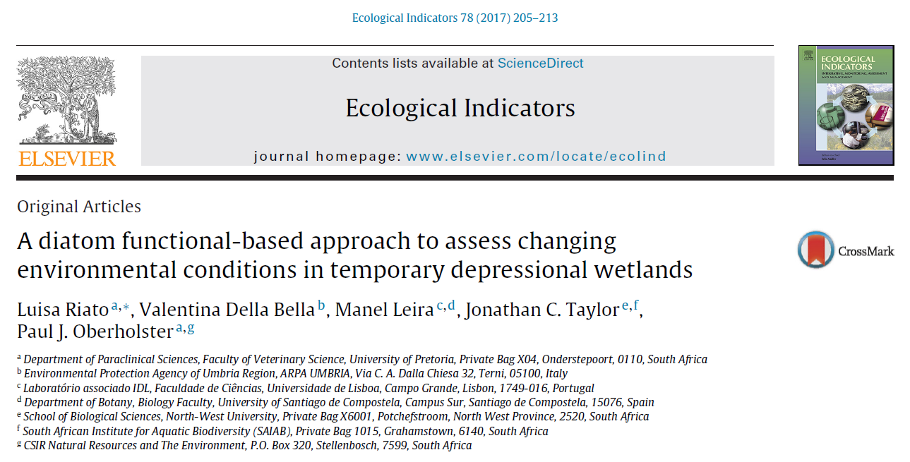
Publications
Presentation

Slide 22
Guidelines
Macfarlane D; Dlamini B, Marneweck G, Kassier D, Campbell J, Young A, Dini J, Holness S, de Klerk AR, OBERHOLSTER PJ, & Ginsburg A. (2016) Wetland Rehabilitation in mining landscape: An introductory Guide. Water Research Commission, Pretoria K5/2203 A. (Government Gazette 24 March 2017, no 407/3)
Holness S, Dini J, de Klerk AR, & OBERHOLSTER PJ. (2016) High risk wetlands and associated landscapes: Reference Guide and Technical Metadata for the Mpumalanga Mining Decision Support Tool. Water Research Commission, Pretoria K5/2203 B. (Government Gazette 24 March 2017, no 407/3)
OBERHOLSTER P.J, P McMillan, & P.J. Ashton (2009) Wetland index manual for classification and risk assessment of wetlands in the Mpumalanga ecoregion, South Africa. CSIR Report No. CSIR/NRE/WR/IR/2009/0048/C, pp. 74.

